Slide 1
Revisiting the Correspondence
between affective experience and psychophysiological reactivity
Alina Koppold & Carlos Ventura-Bort
18/09/2023

Slide 2
Affect is the general sense of feeling experienced throughout each day, characterized by two features: valence and arousal (Barrett & Russell, 1999).
Valence: hedonic value (ranging from pleasant to unpleasant)
Arousal: degree of activation (ranging from calm to active,
excited).

Slide 3
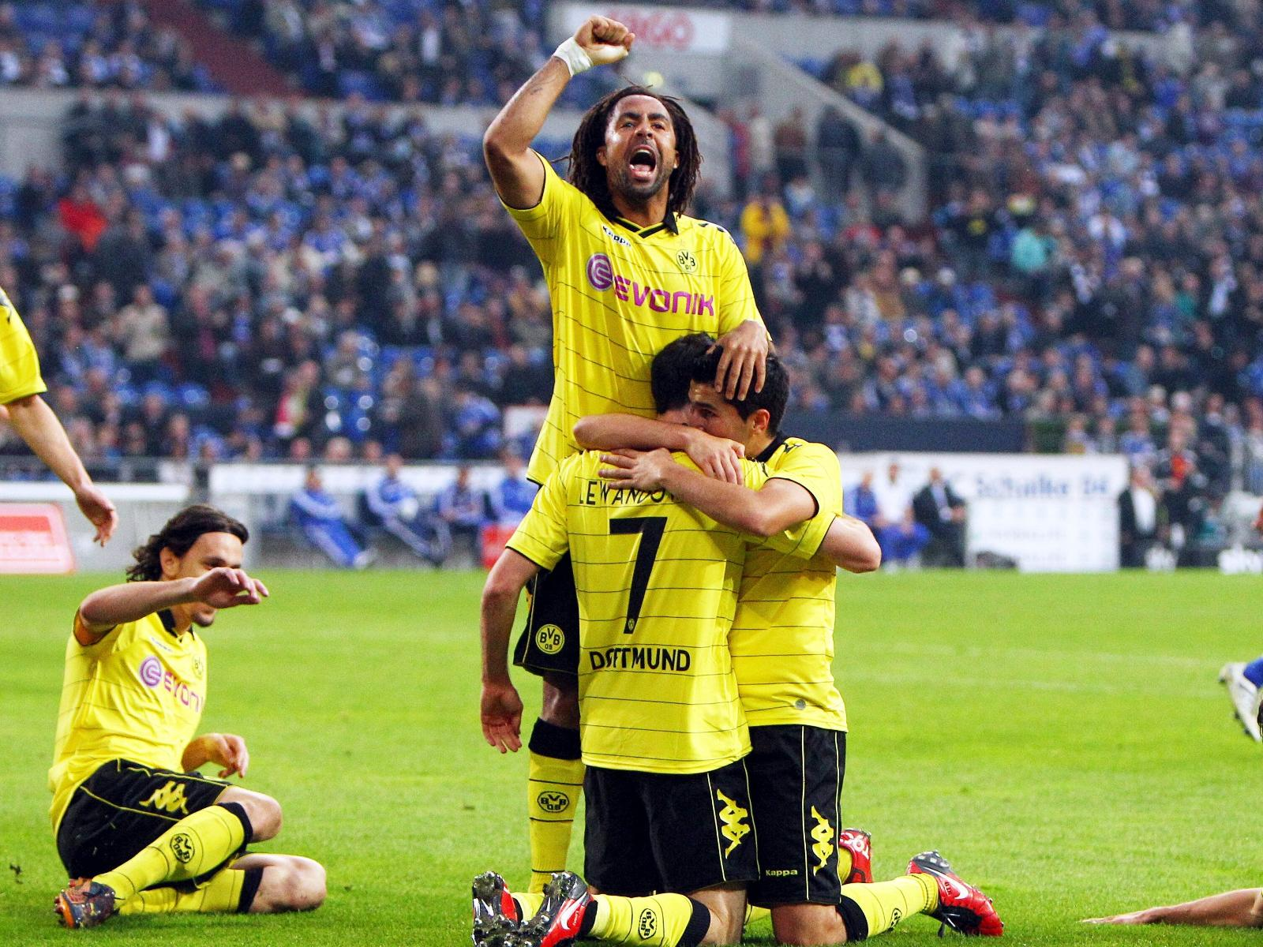
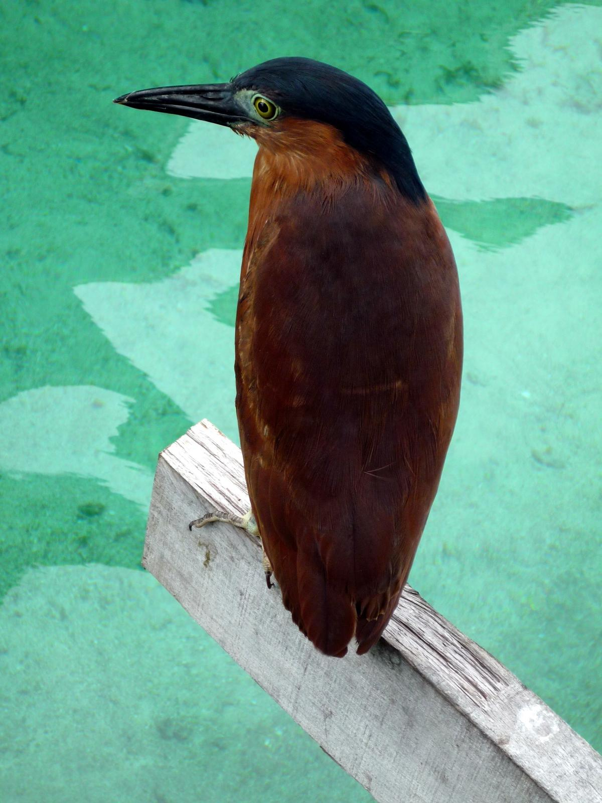
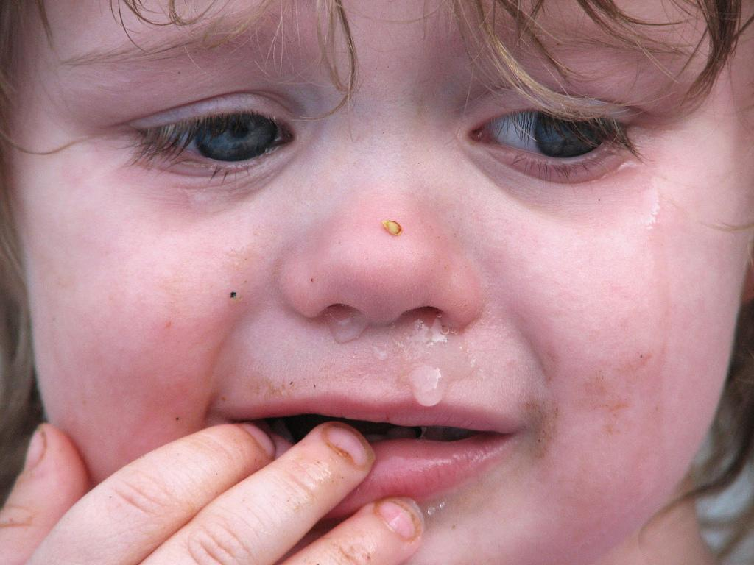
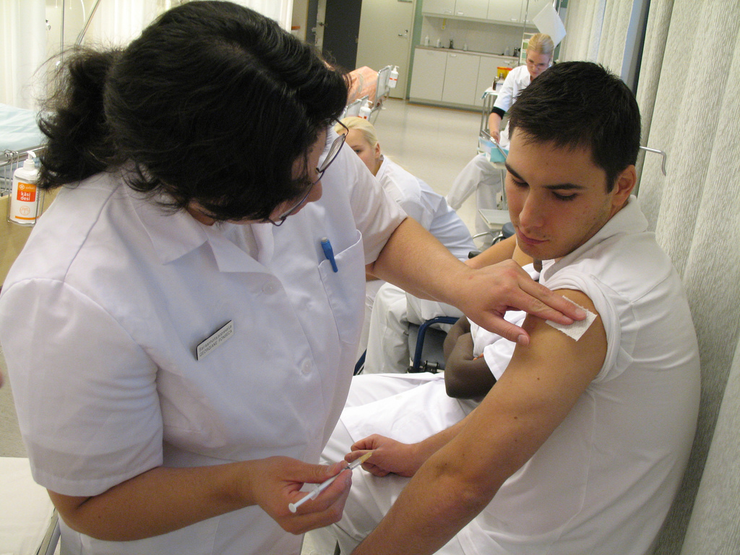
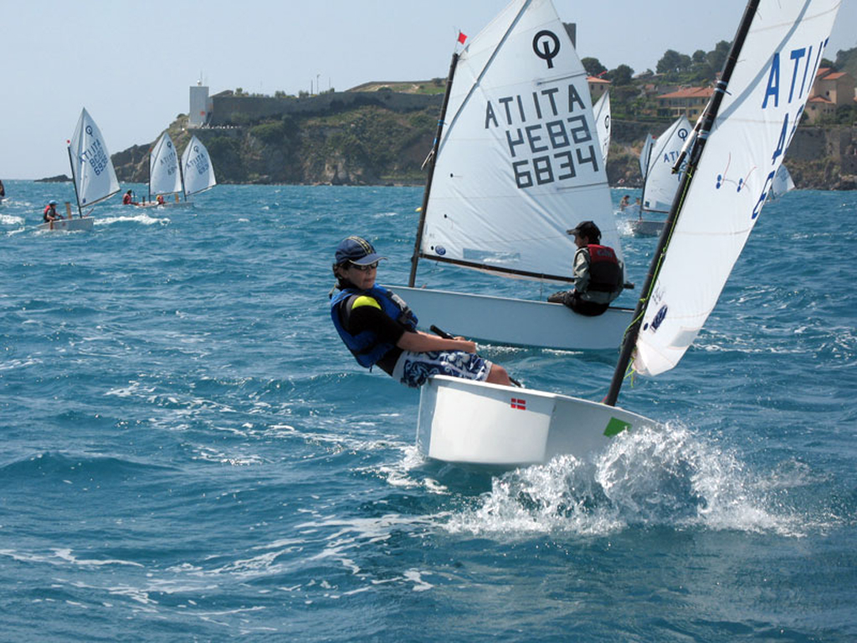

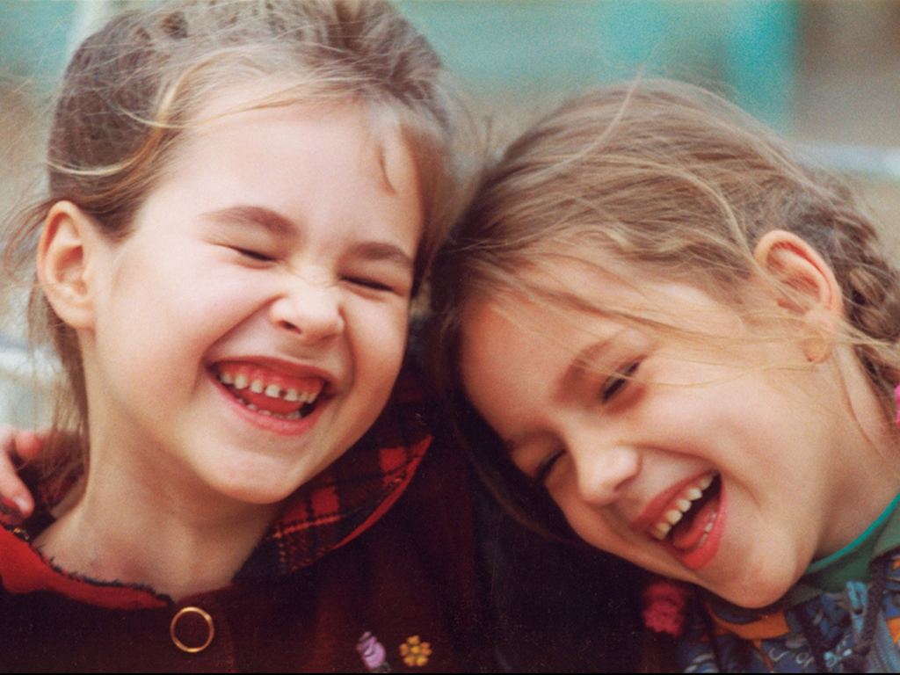
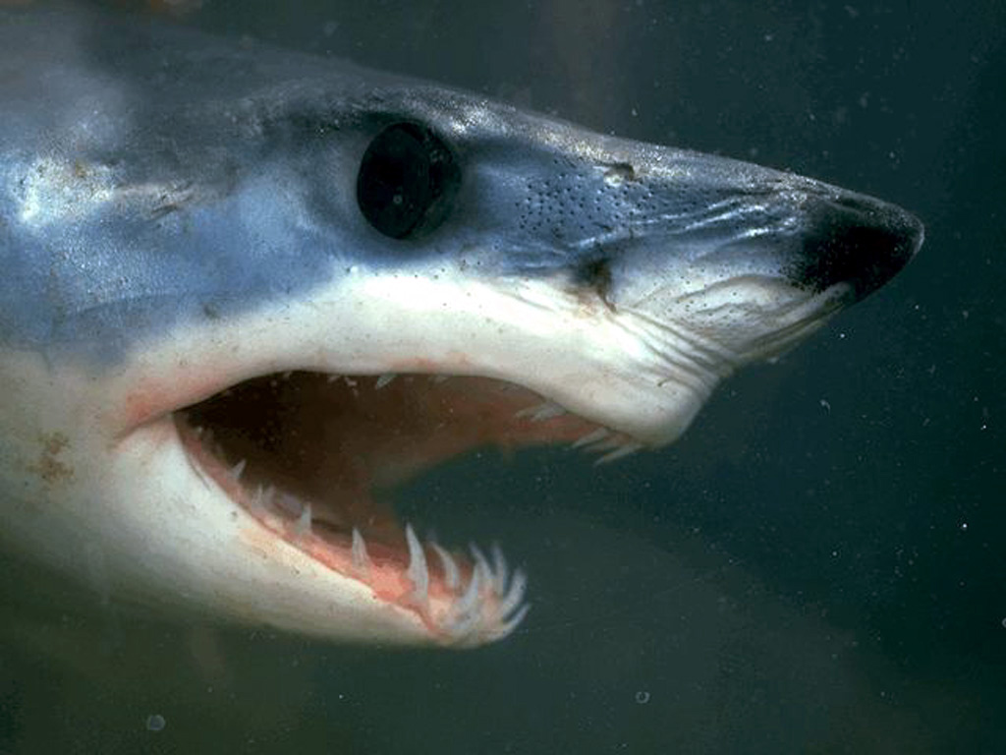
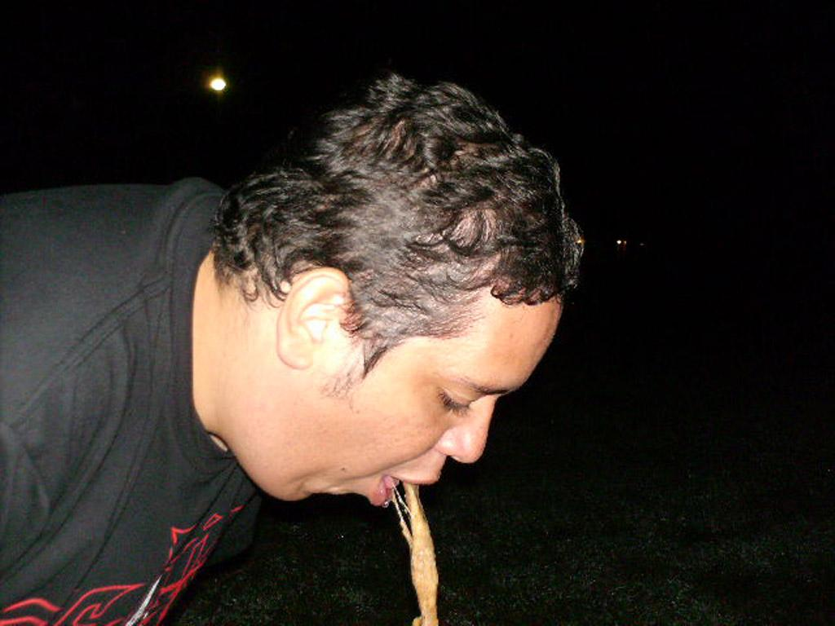
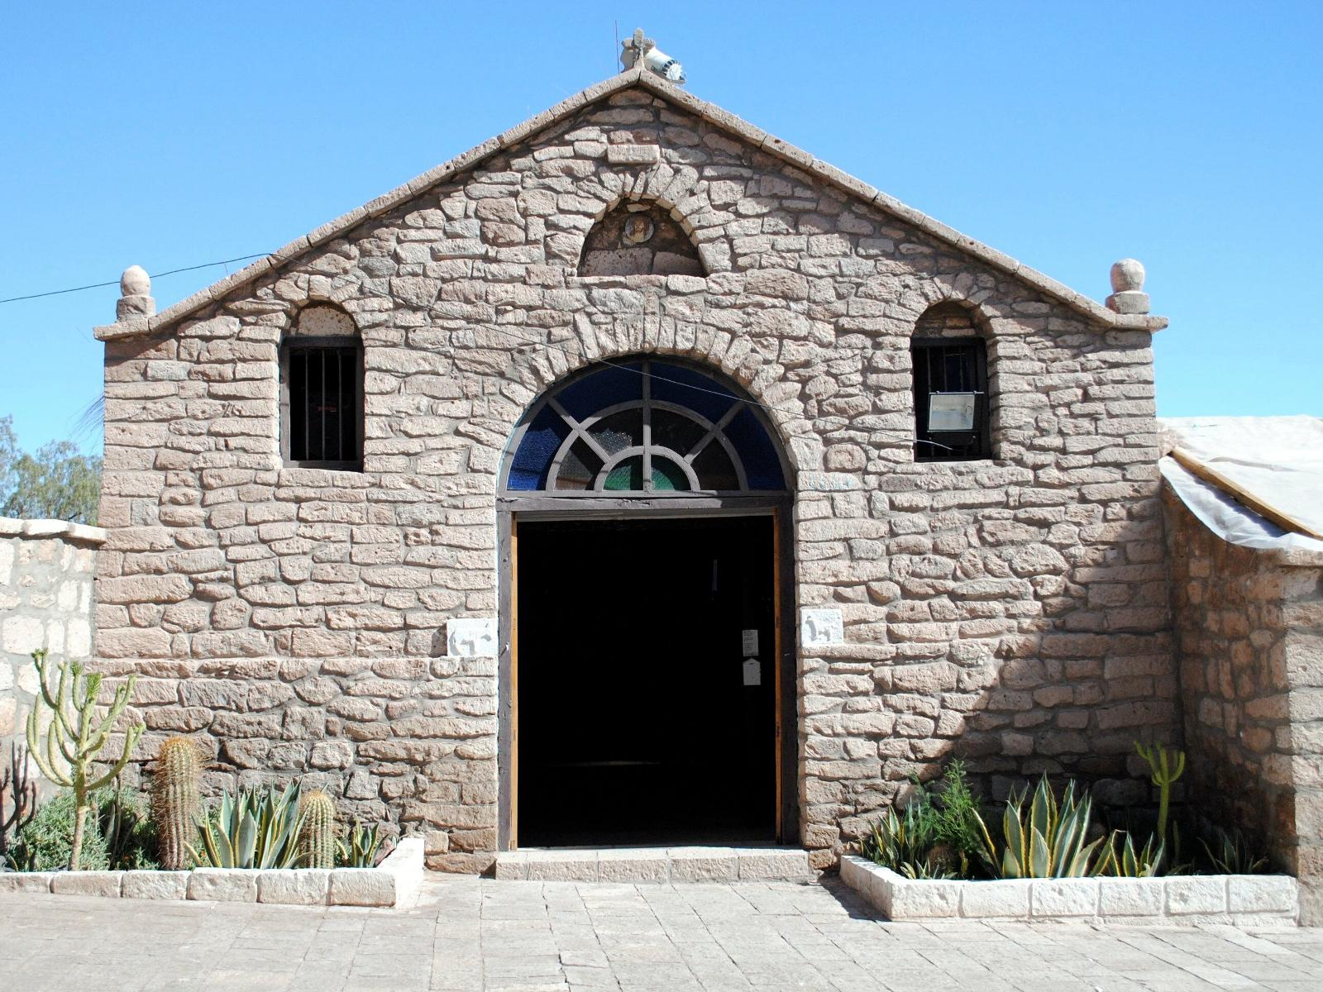
We tend embed events categories: Based on their similarities on a specific constructs.

Slide 4
Events are grouped based on their similarities in the construct valence

Slide 5
Events are grouped based on their similarities in the construct Arousal

Slide 6
Physiological reactivity and psychological constructs
To assume that a physiological response is a correlate of a psychological construct implies that events that are similar in that construct will evoke similar responses.
The more similar two event are in psychological category, the more similar the evoked physiological response should be.

Slide 7
The more similar event are in psychological dimension, the more similar the evoked physiological response should be
Calm Arousal Exciting
More similar
Less similar

Slide 8
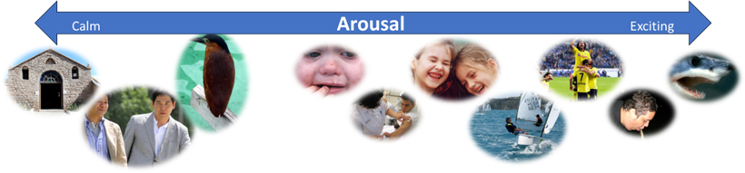
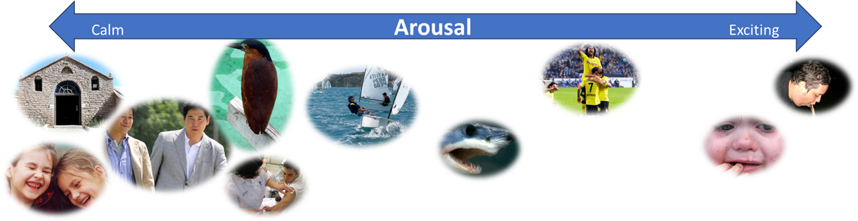
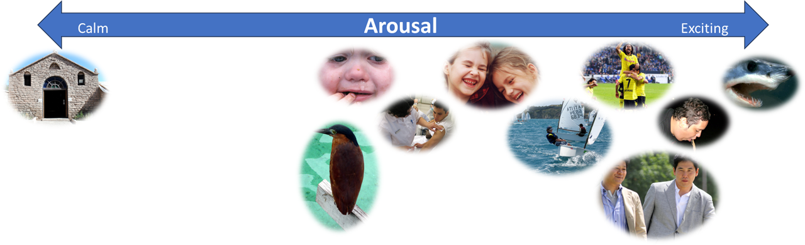
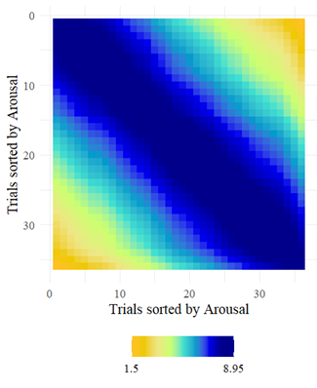
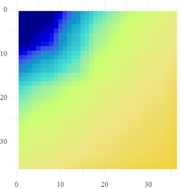
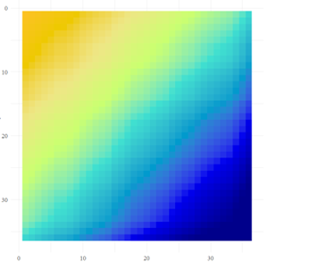
RSA as a distance metric: two models
Nearest Neighbors (NN) model
Anna-Karenina Effect (AK or invAK, Finn et al., 2018, 2020)
behavior that is measured on a scale from 0 to 100, a pair of trials scoring 0 and 1 should be just as similar as a pair of trials scoring 8 and 9 (since in both cases, the Euclidean distance is 1)
example invAK: low-scoring trials are more similar to other low scoring trials, while high-scoring trials are less similar both to high scoring and other low scoring trials= “All calming trials are alike; every exciting trial is in its own way”
example AK: high-scoring trials are more similar to other high-scoring trials, while low-scoring trials are less similar both to high- and other low-scoring trials= “All exciting trials are alike; each calming trials is in its own way”
Less similar
More similar

Slide 9
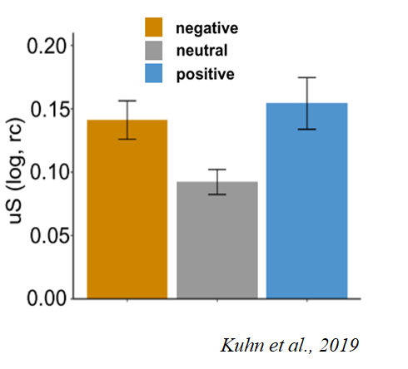
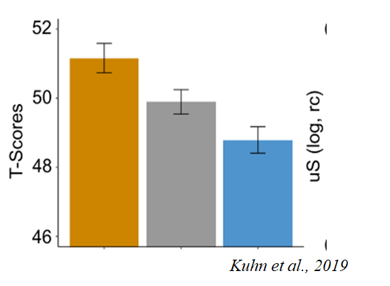
Research Questions
What is the similarity between physiological reactivity during affective processing tasks with the affective dimensions of valence and arousal?
Two measures:
Skin Conductance Response as a correlate of arousal
Startle blink reflex as a correlate of valence

Slide 10
Data, Tasks, and Models
Dataset 1: Ventura-Bort et al. 2022 (N total = 65)
 | passive picture viewing task | sound listening task | imagery task | models | Alternative models
SCR | x | x | x | NN, invAK | (Time), Category (ne,pl, un), Category 2 (non-arousing, arousing) Valence/arousal
EMG | x | x | x | NN, AK
SCR/ EMG slopes (vector) +
amplitudes
Dataset 2: Koppold et al., 2023 (N total = 491)
SCR | x |  |  | NN, invAK | (Time), Category (ne,pl, un), Category 2 (non-arousing, arousing) Valence/arousal
EMG | x |  |  | NN, AK
SCR/ EMG only
amplitudes

Slide 11
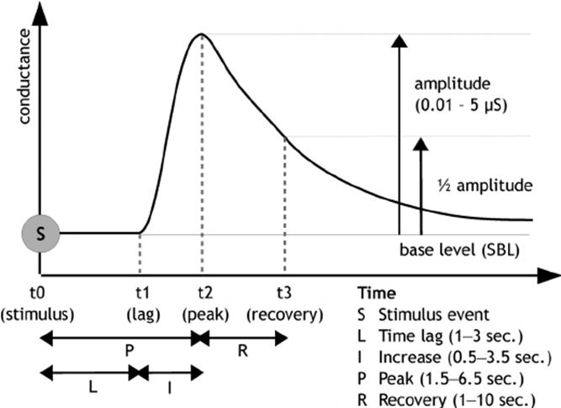
Skin Conductance Response as a correlate of arousal
Which SCR score to use Vector or Amplitude?

Slide 12
Initial Question:
Is there an association between SCR vector (slope) or amplitudes?
This question was answered with the data from Ventura-Bort et al. (2022), since vector (slopes) and amplitudes are available in this dataset. But: across all three tasks (picture viewing, sound listening, imagery).

Slide 13
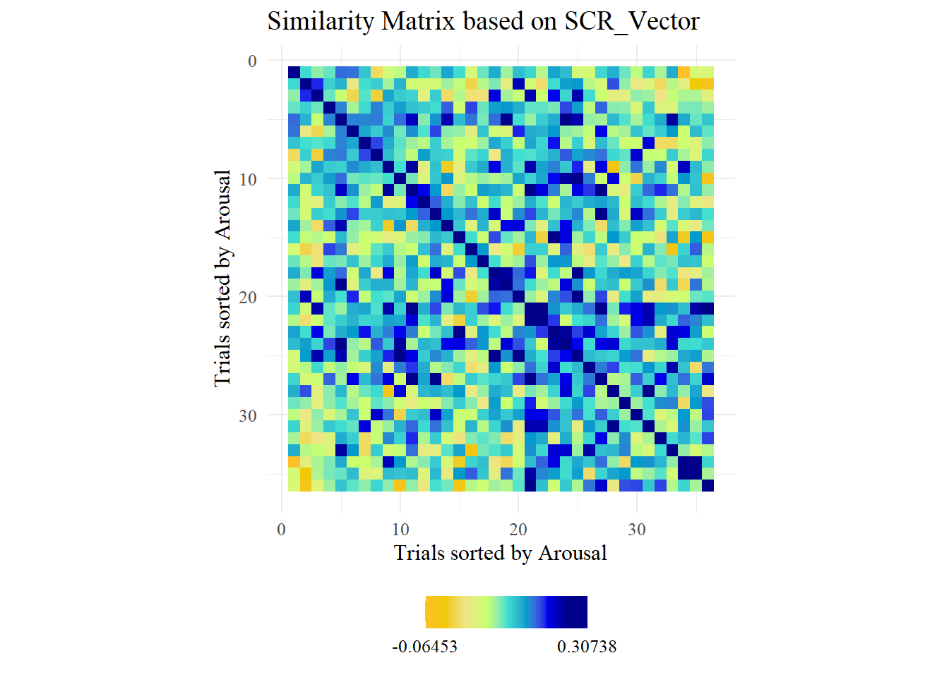
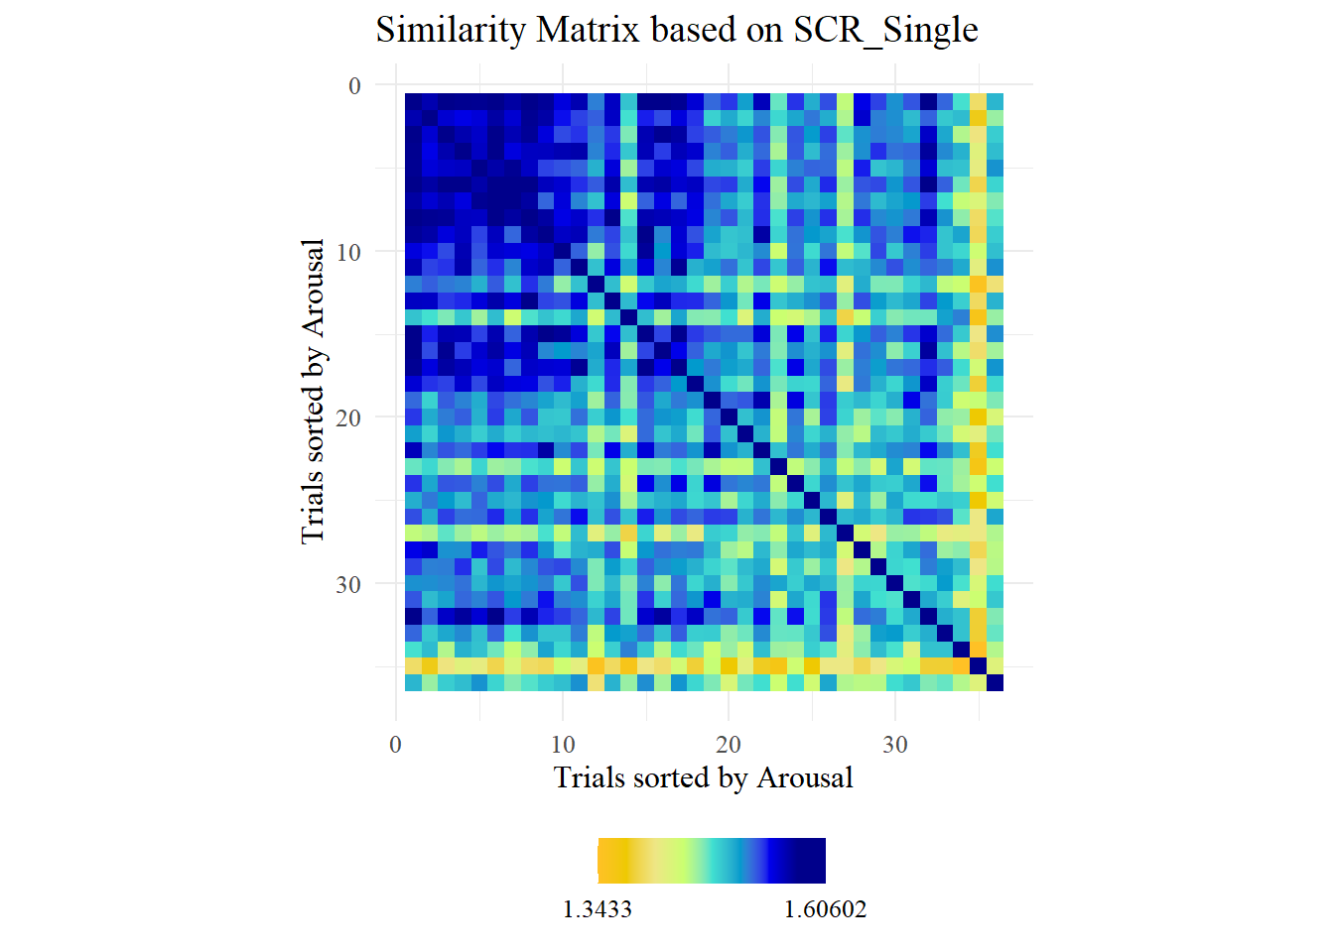
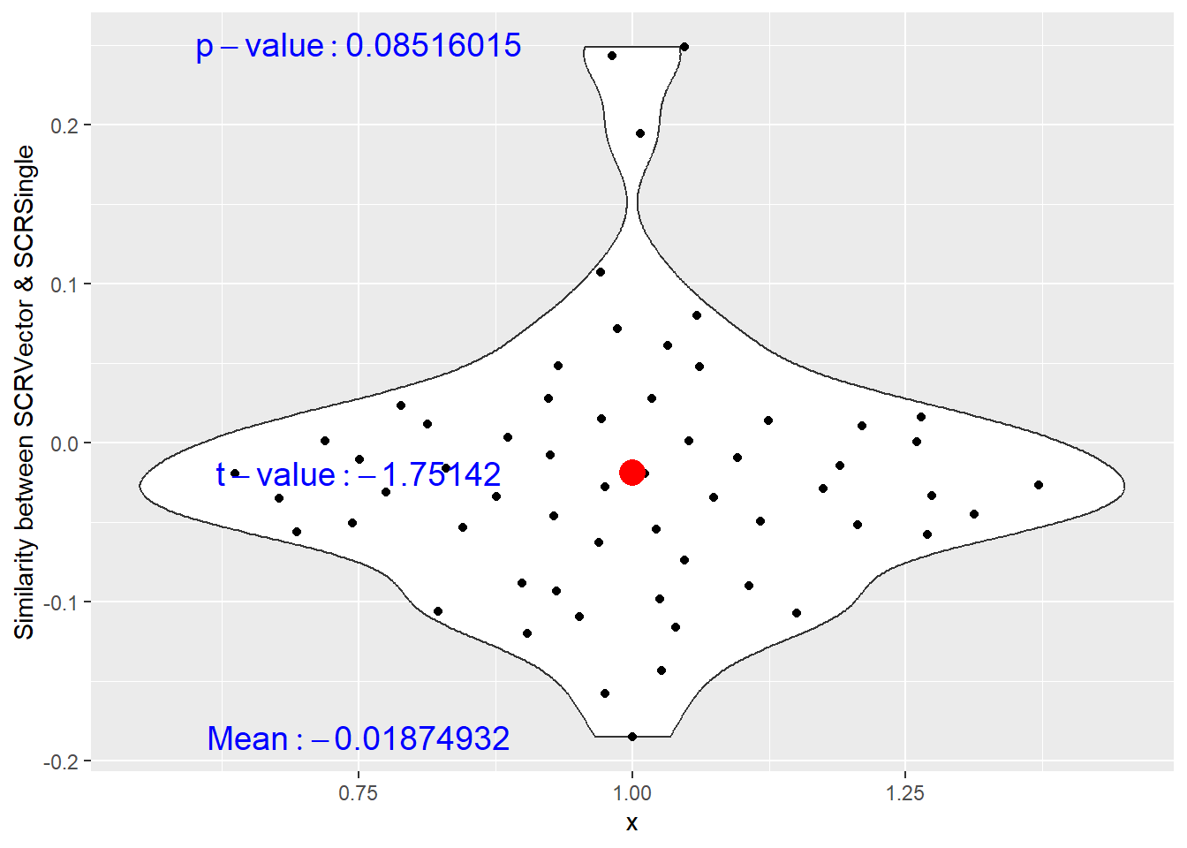
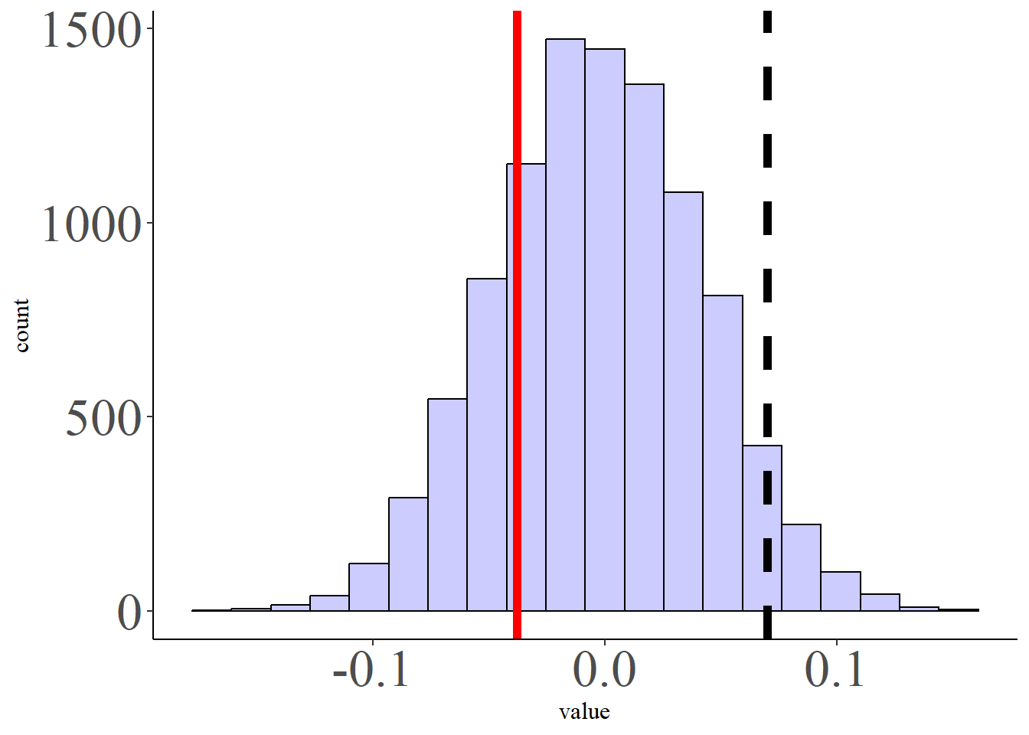
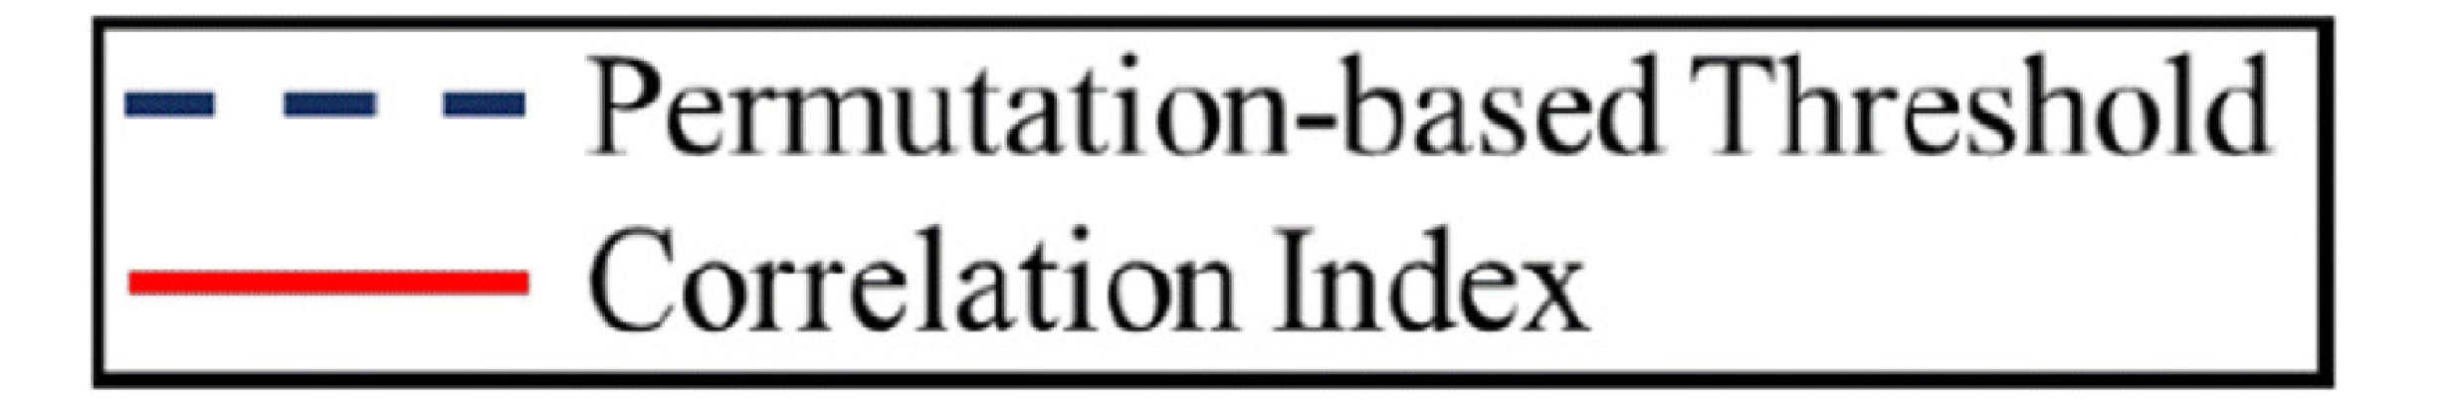
Passive Picture Viewing Task
No similarities between Vector- and Amplitude-based RSMs

Slide 14
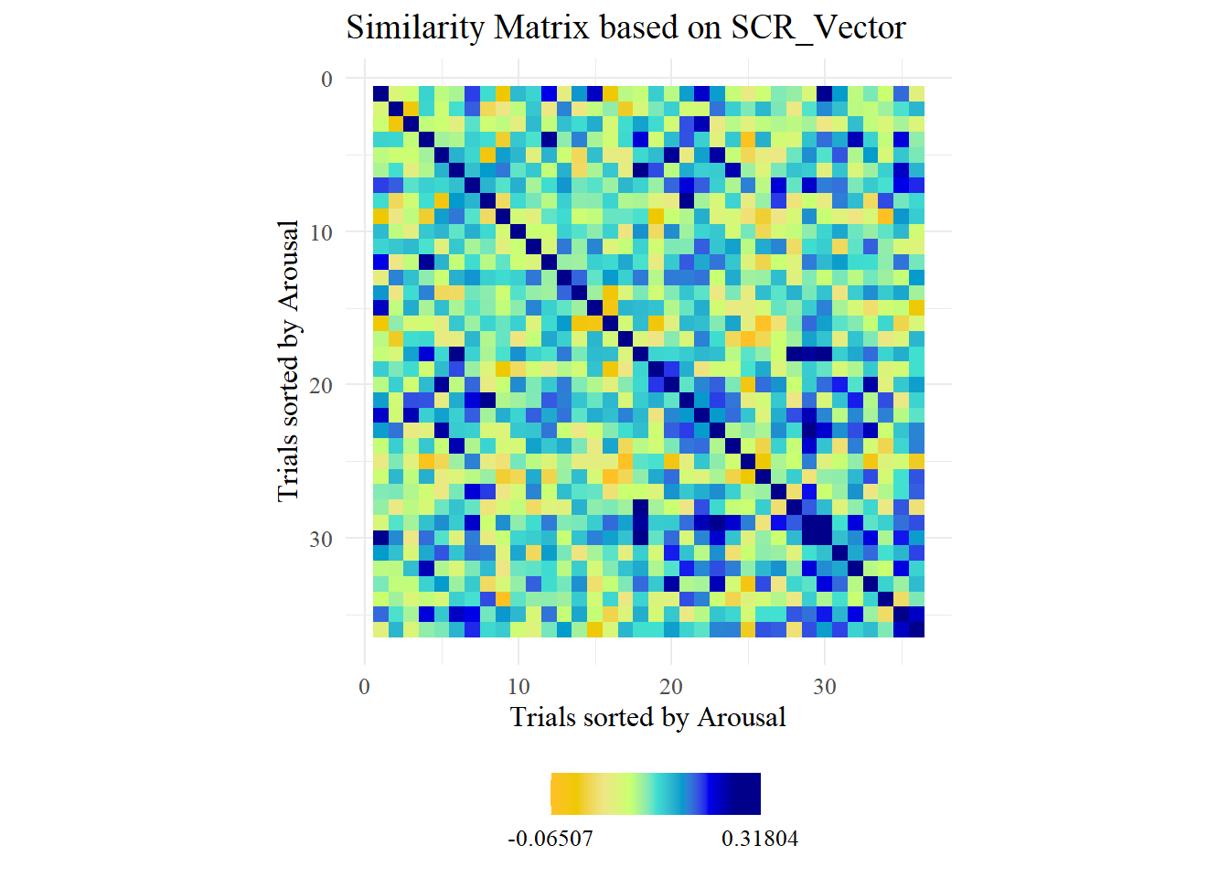
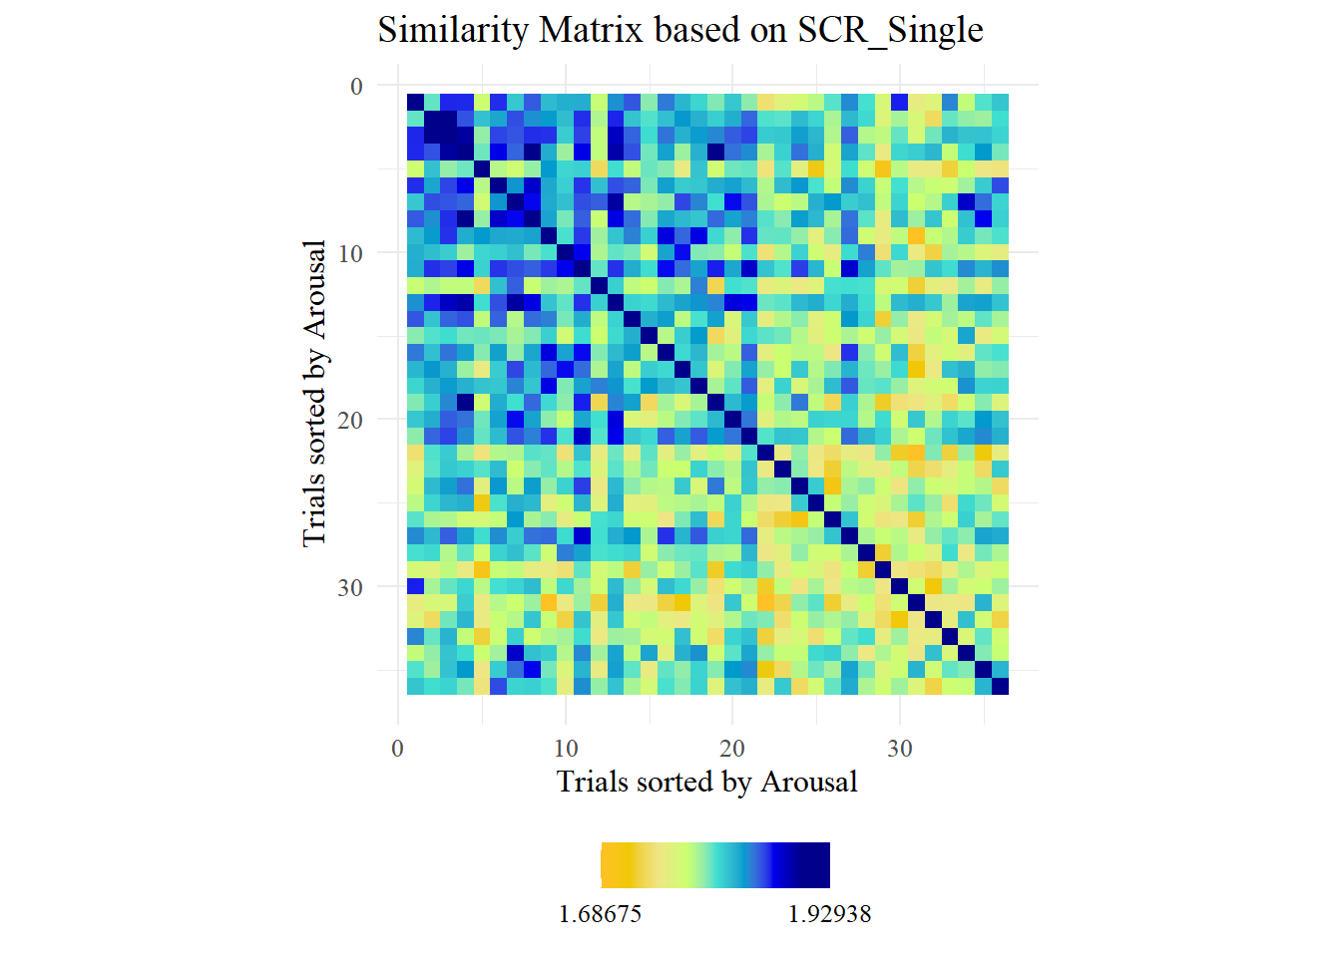
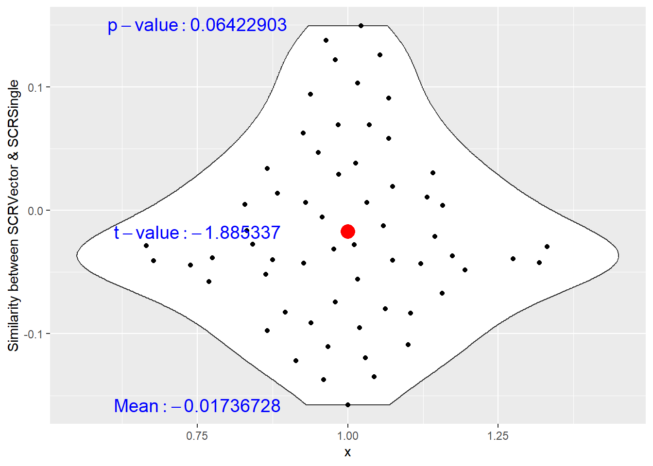
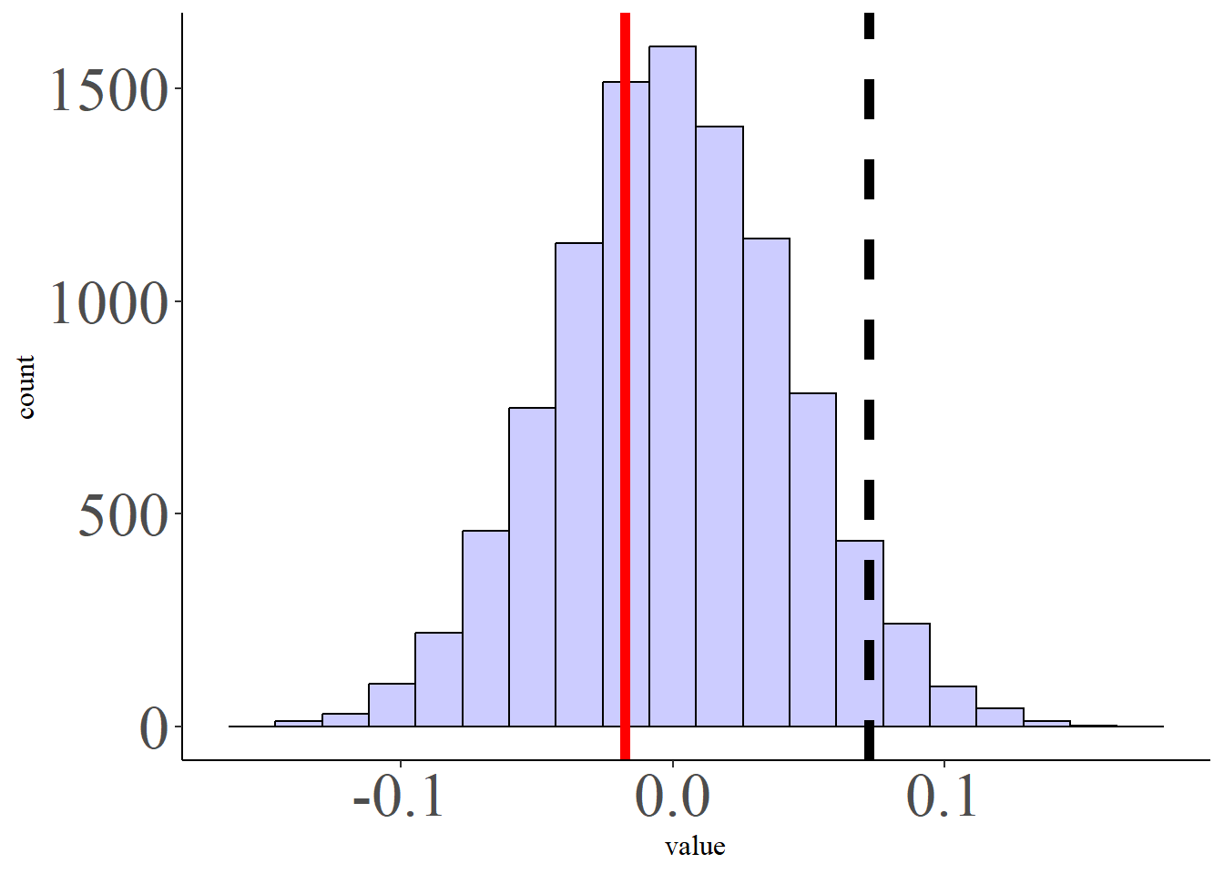
Passive Sound Listening Task
No similarities between Vector- and Amplitude-based RSMs

Slide 15
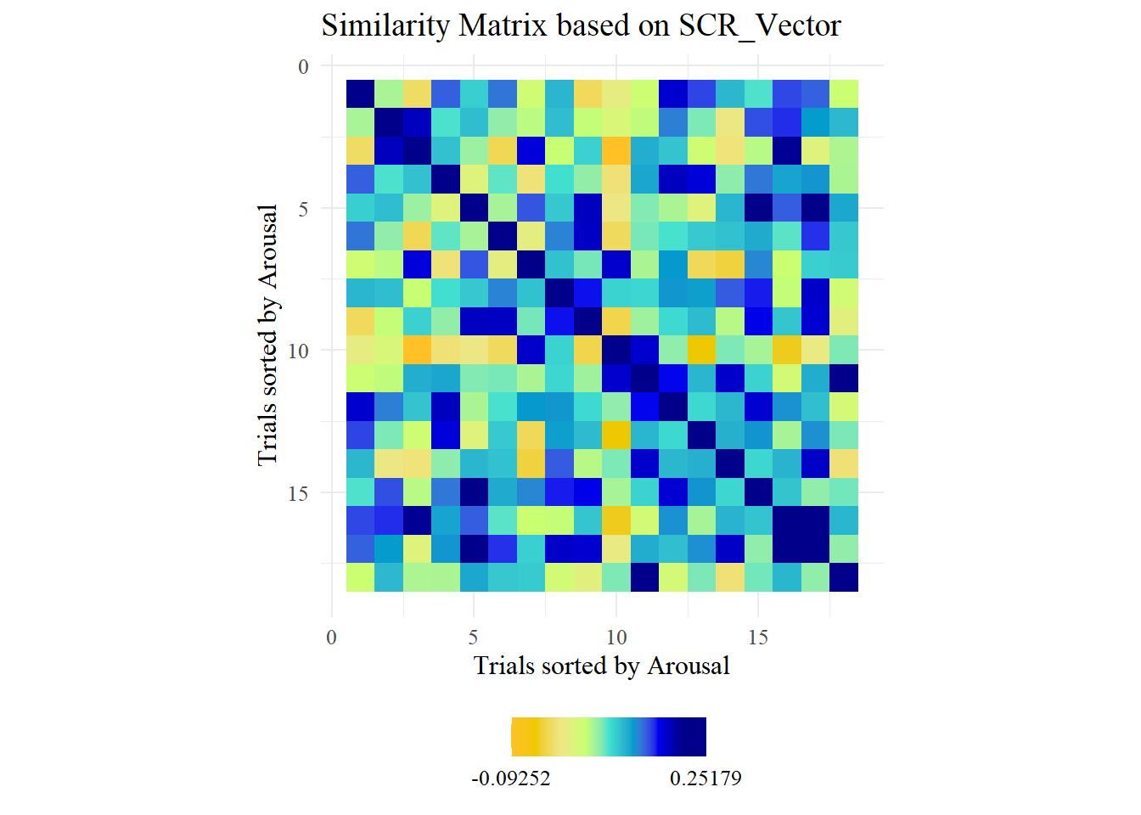
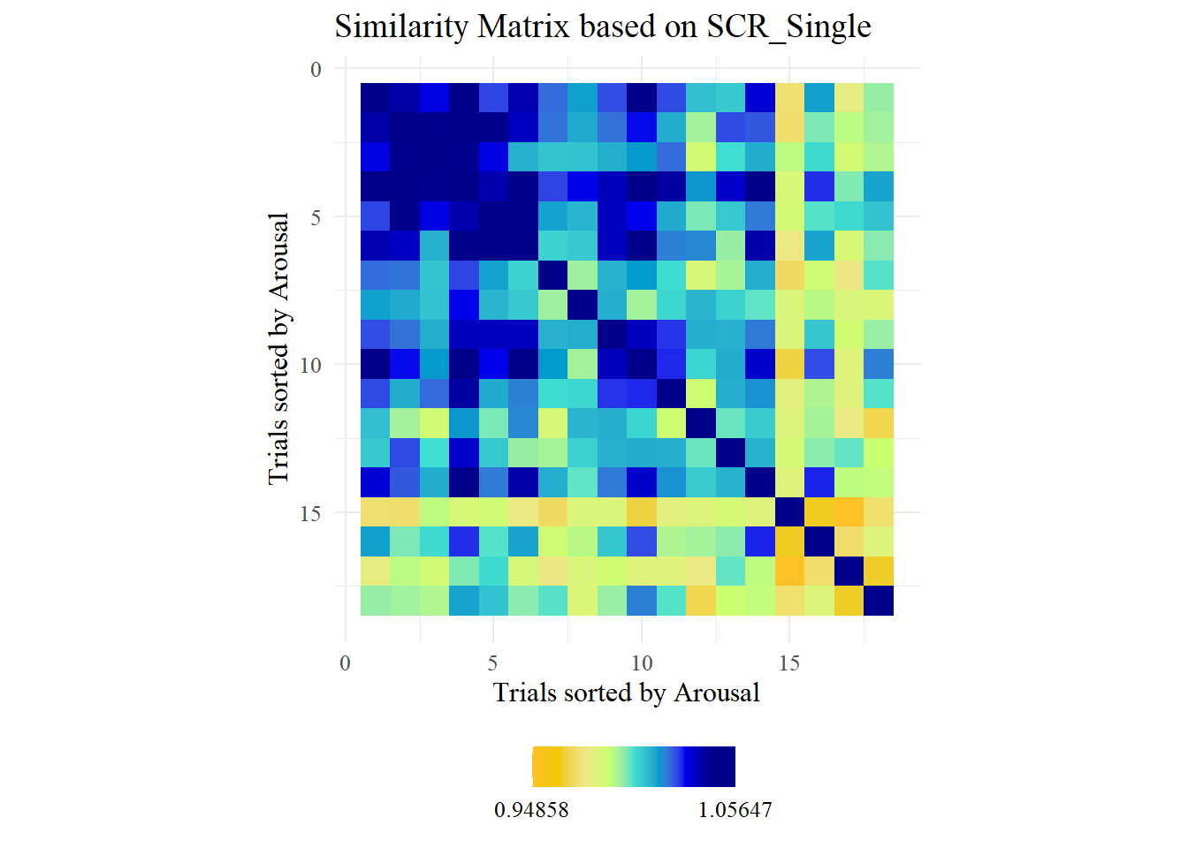
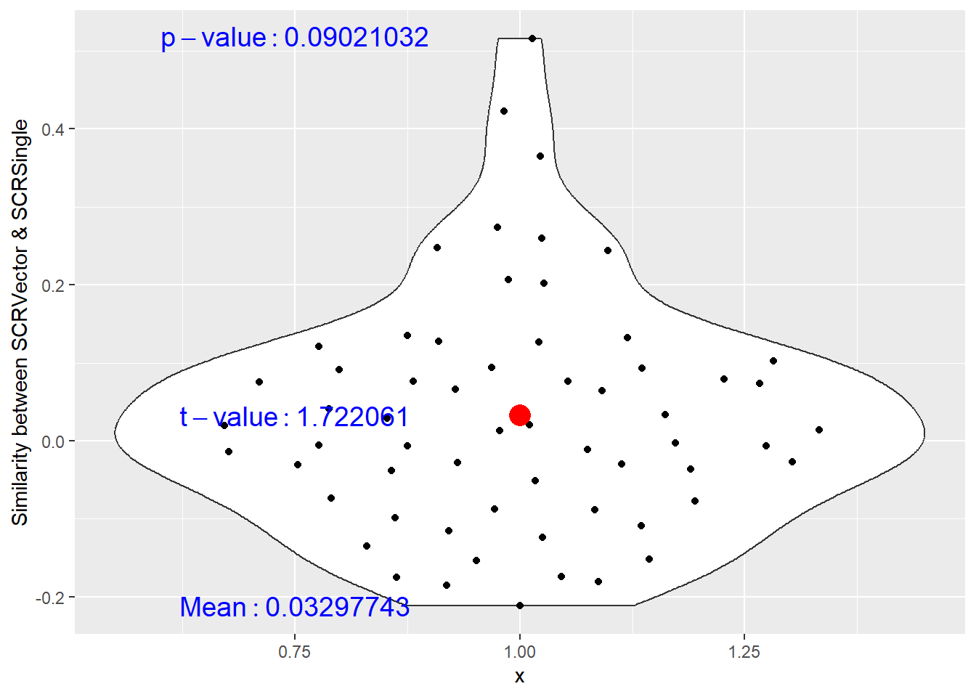
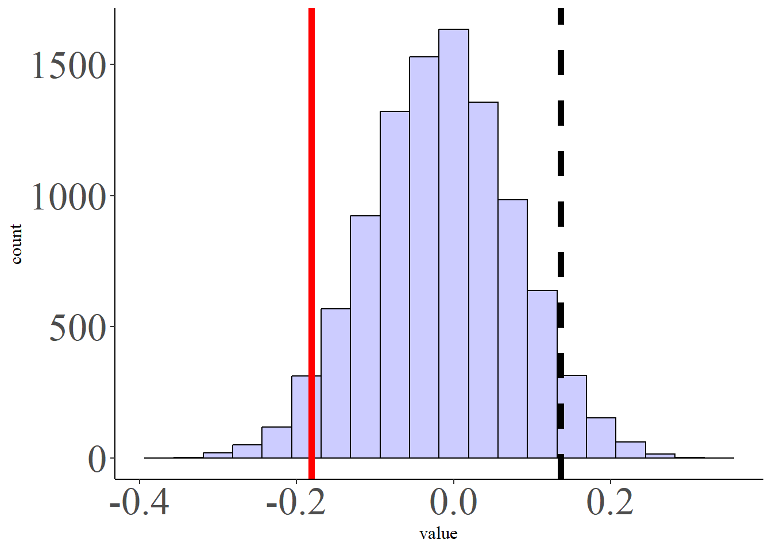
Imagery Task
No similarities between Vector- and Amplitude-based RSMs

Slide 16
Initial Question:
Is there an association between SCR vector (slope) or amplitudes?
→ RSMs of SCR based on Vector are not similar to the RSMs matrices based on amplitudes.
→ On which measure should we focus?
The most coherent across tasks.
(in the dataset of Koppold et al., 2023 only amplitudes are available)

Slide 17
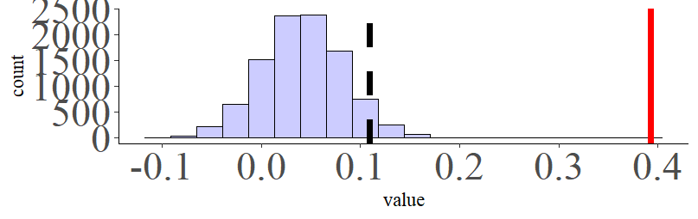
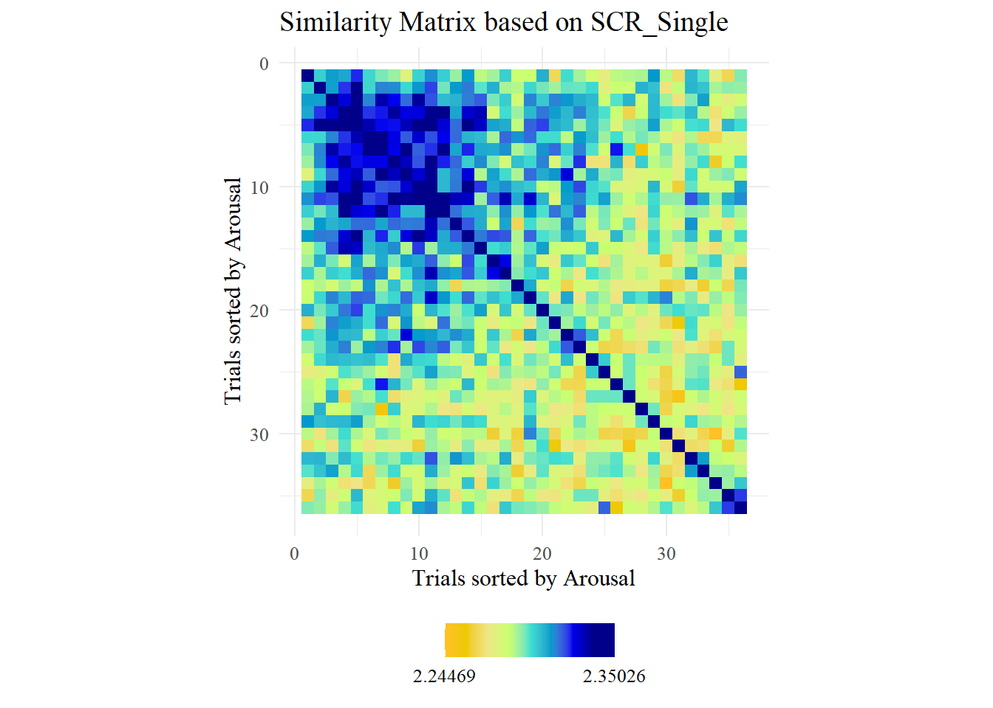
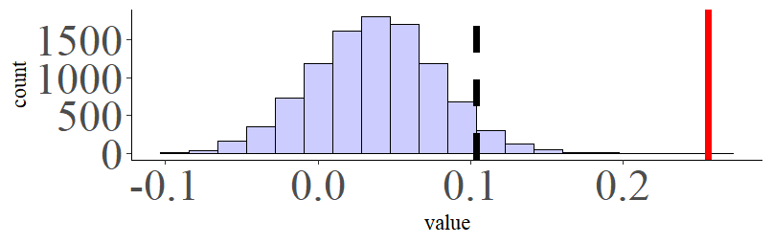
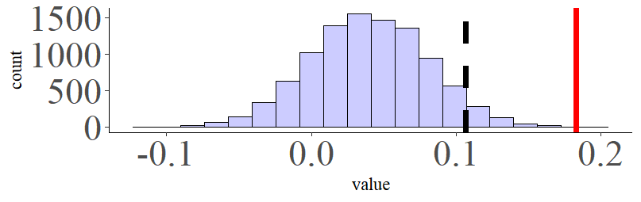
Comparison across data sets and tasks
Koppold et al., 2023
PPV Ventura-Bort et al., 2022
similar patterns across tasks and samples
conclusion:
PSL Ventura-Bort et al., 2022
To test for the similarities between startle RSMs from different tasks, the startle RSMs for the PPV and PSL were also compared, revealing no significant relation (r = −.03, p = .64, BF10 = 0.01).

Slide 18
Research Questions
What is the similarity between physiological reactivity during affective processing tasks with the affective dimensions of valence and arousal?
Two measures:
Skin Conductance Response as a correlate of arousal
Startle blink reflex as a correlate of valence

Slide 19
2. Which Model of Arousal (rating) shows a stronger correspondence with RSMs of SCR?
Nearest Neighbors (NN) model
Anna-Karenina Effect (AK or invAK)
Notes:
inv AK or AK decision/ rational after testing

Slide 20
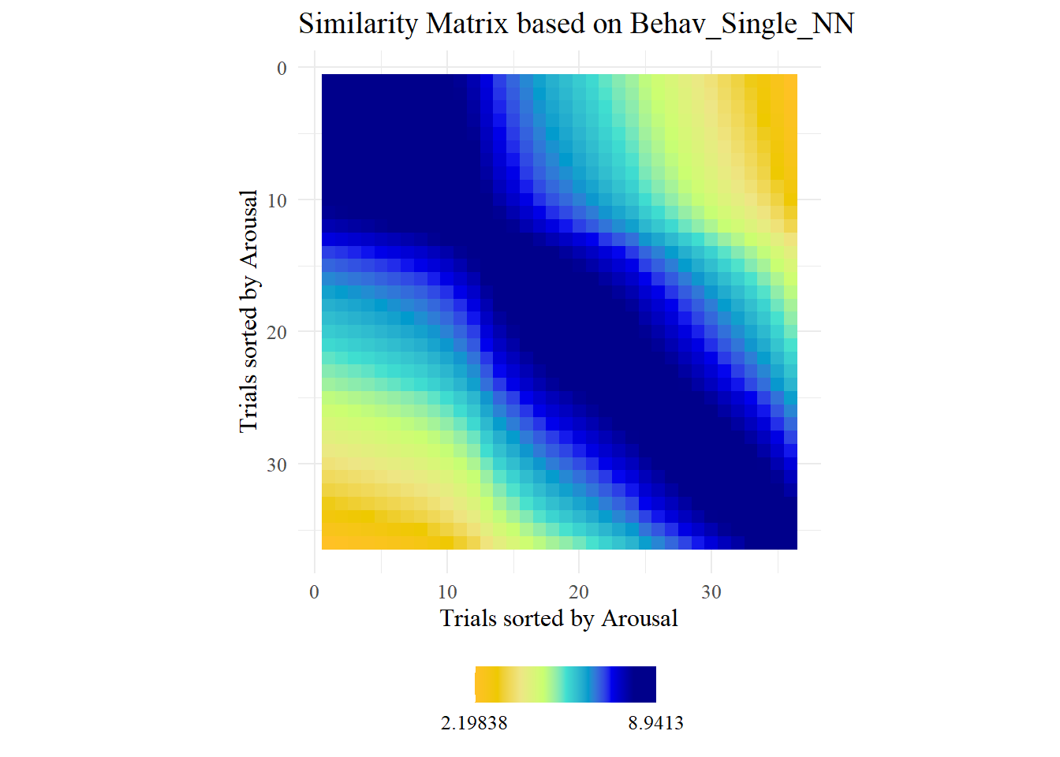
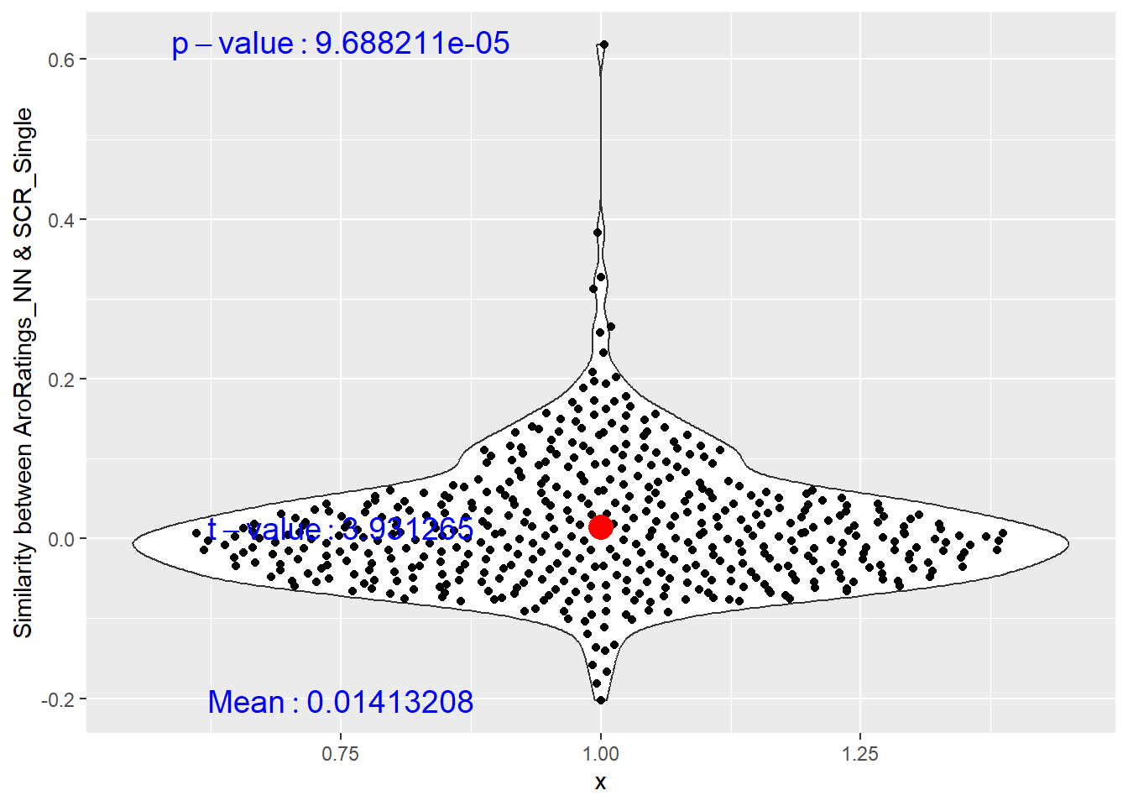
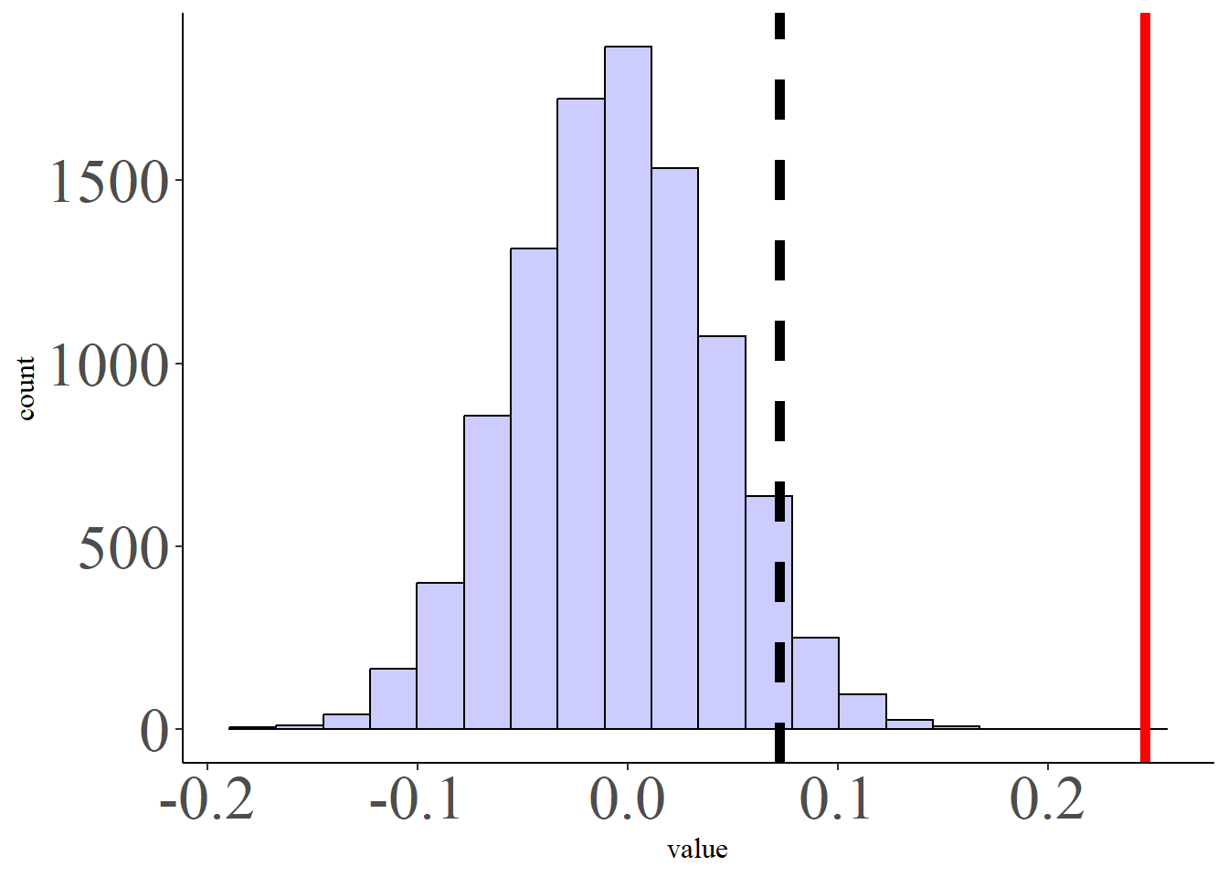
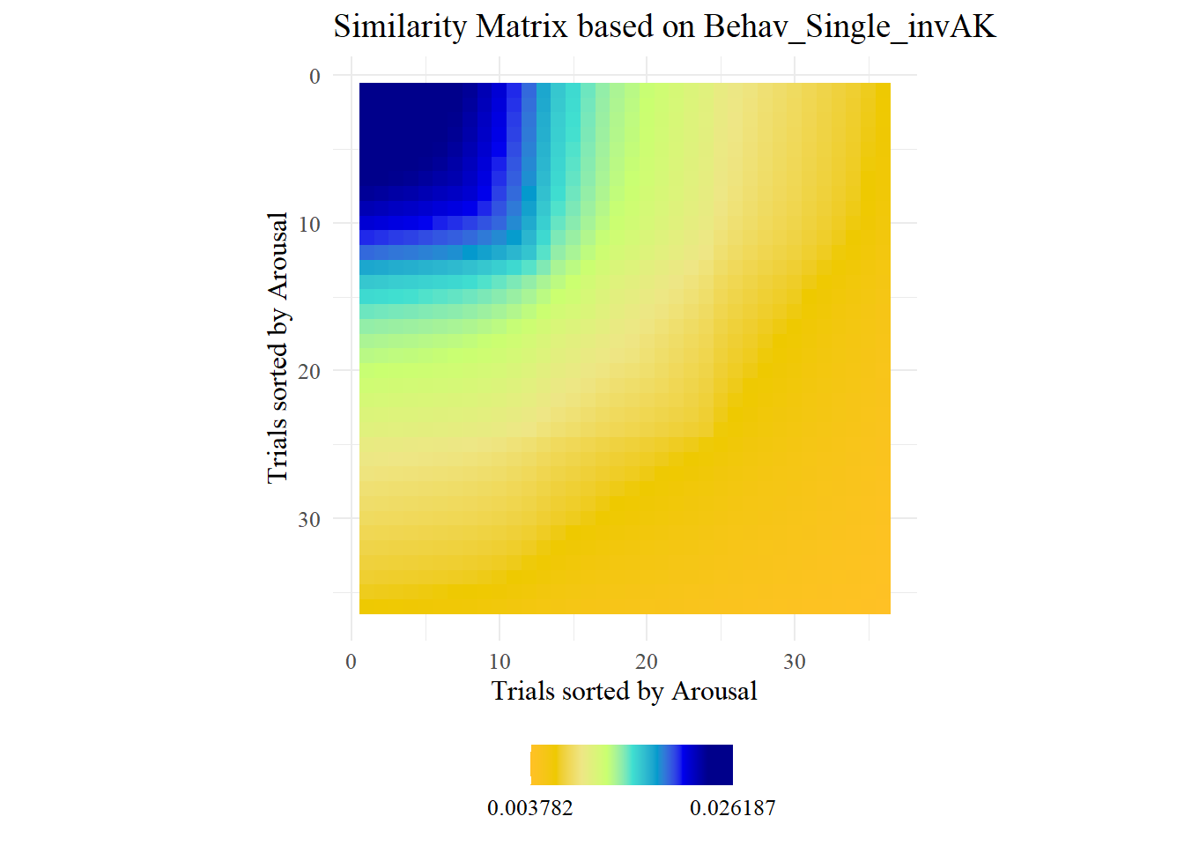
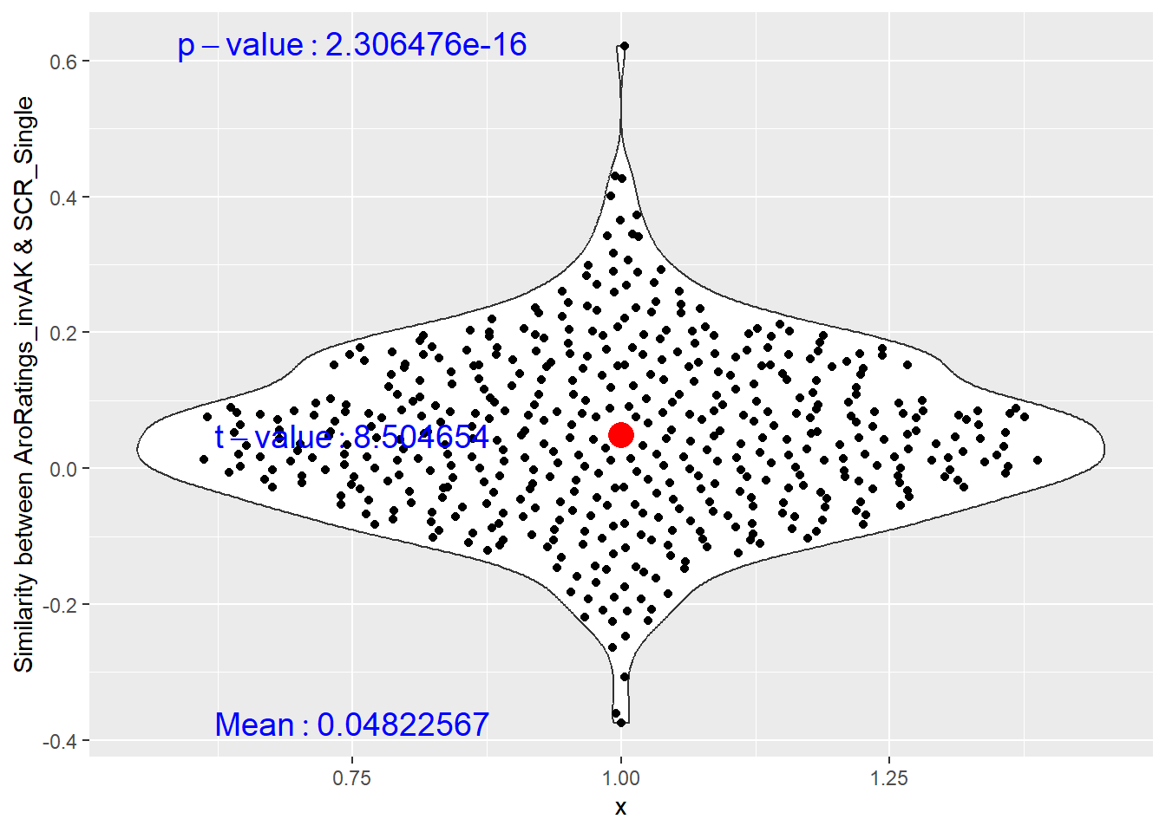
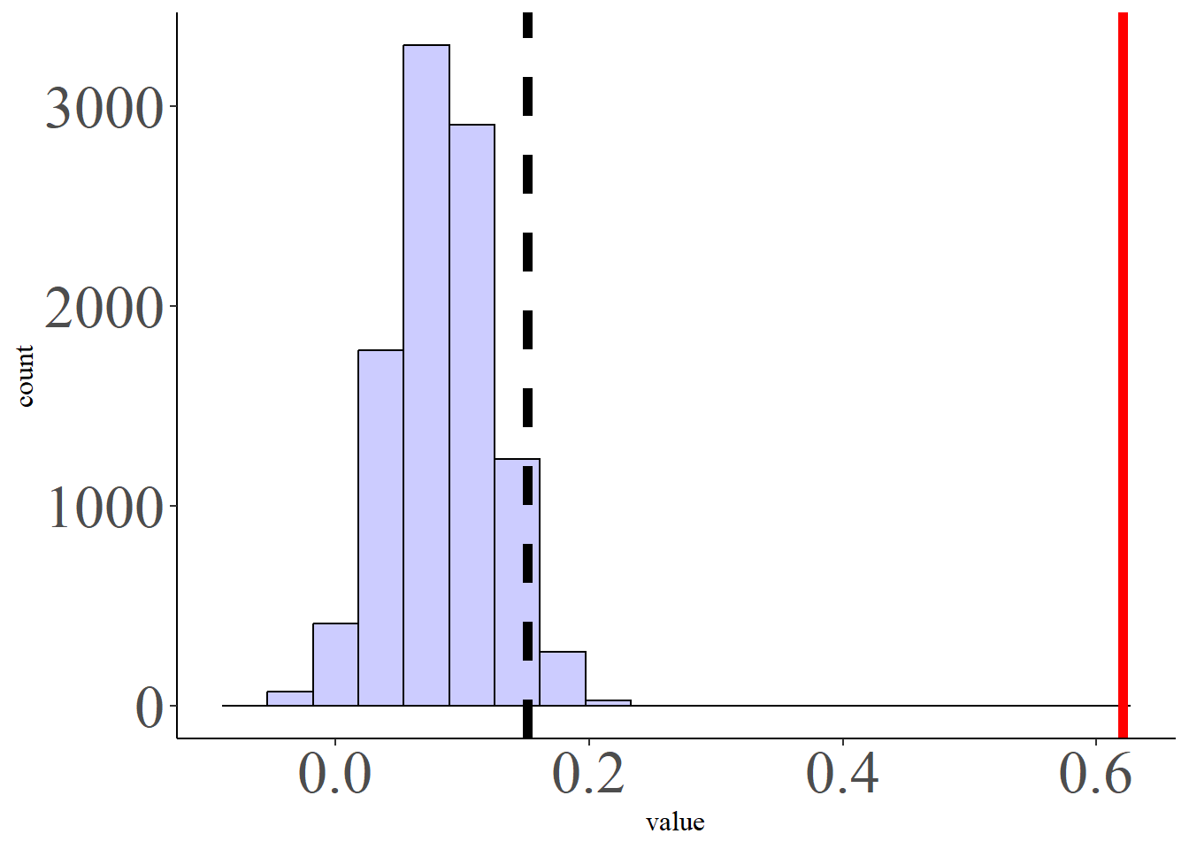
Comparison between RSMs of SCR and NN and invAK Data: Koppold et al., 2023
permutation test
Individual-based similarity

Slide 21
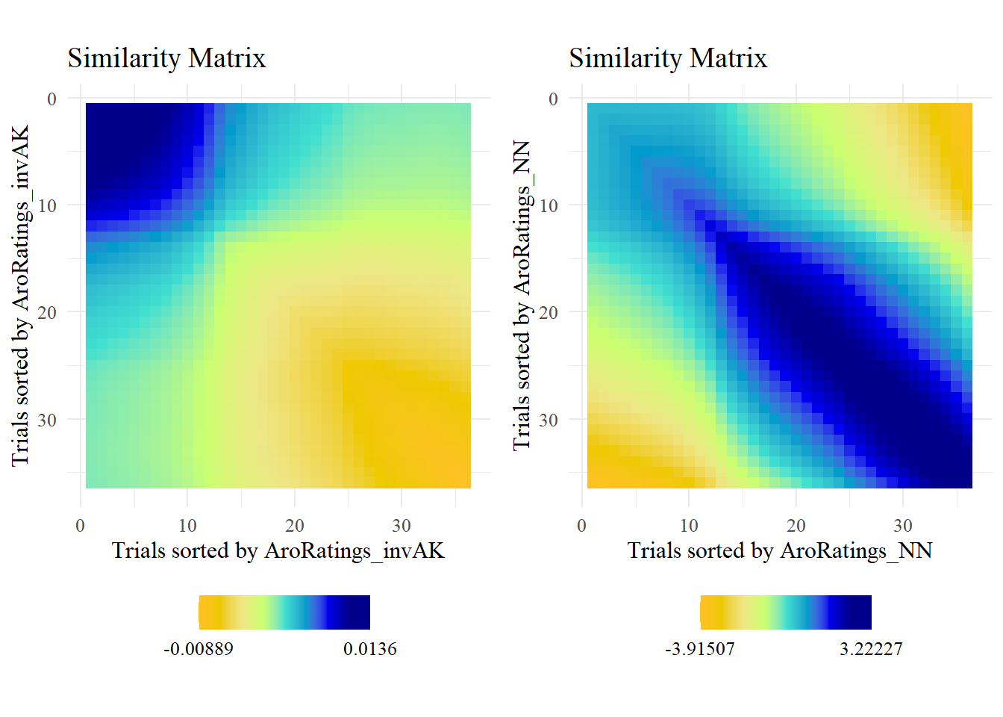
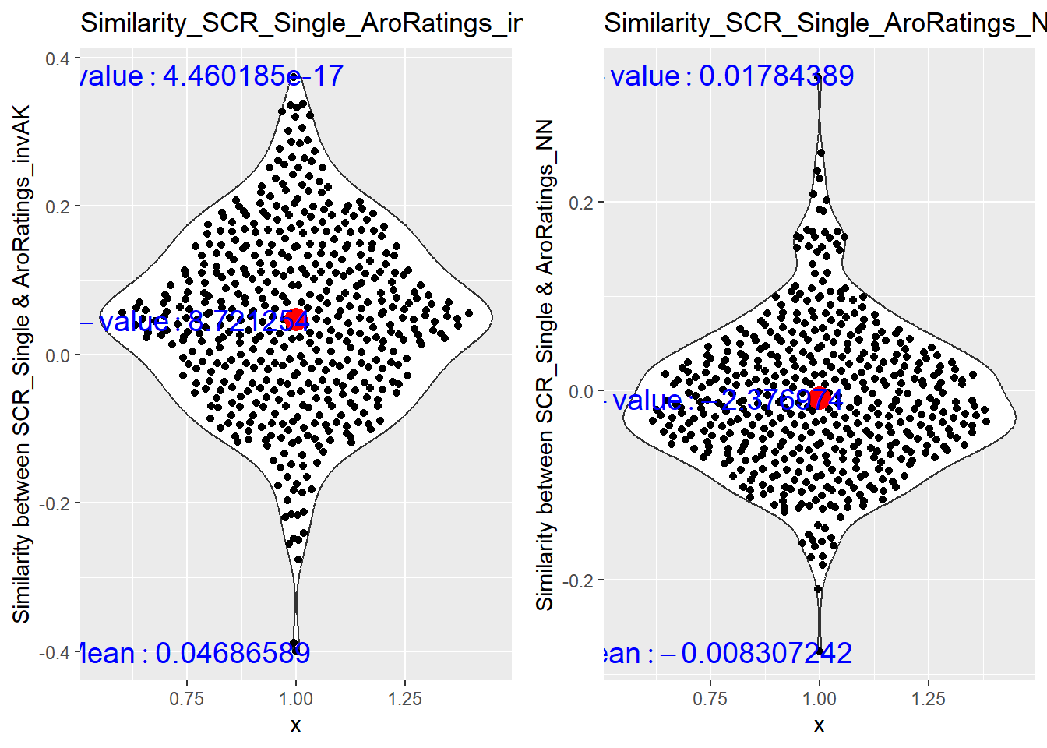
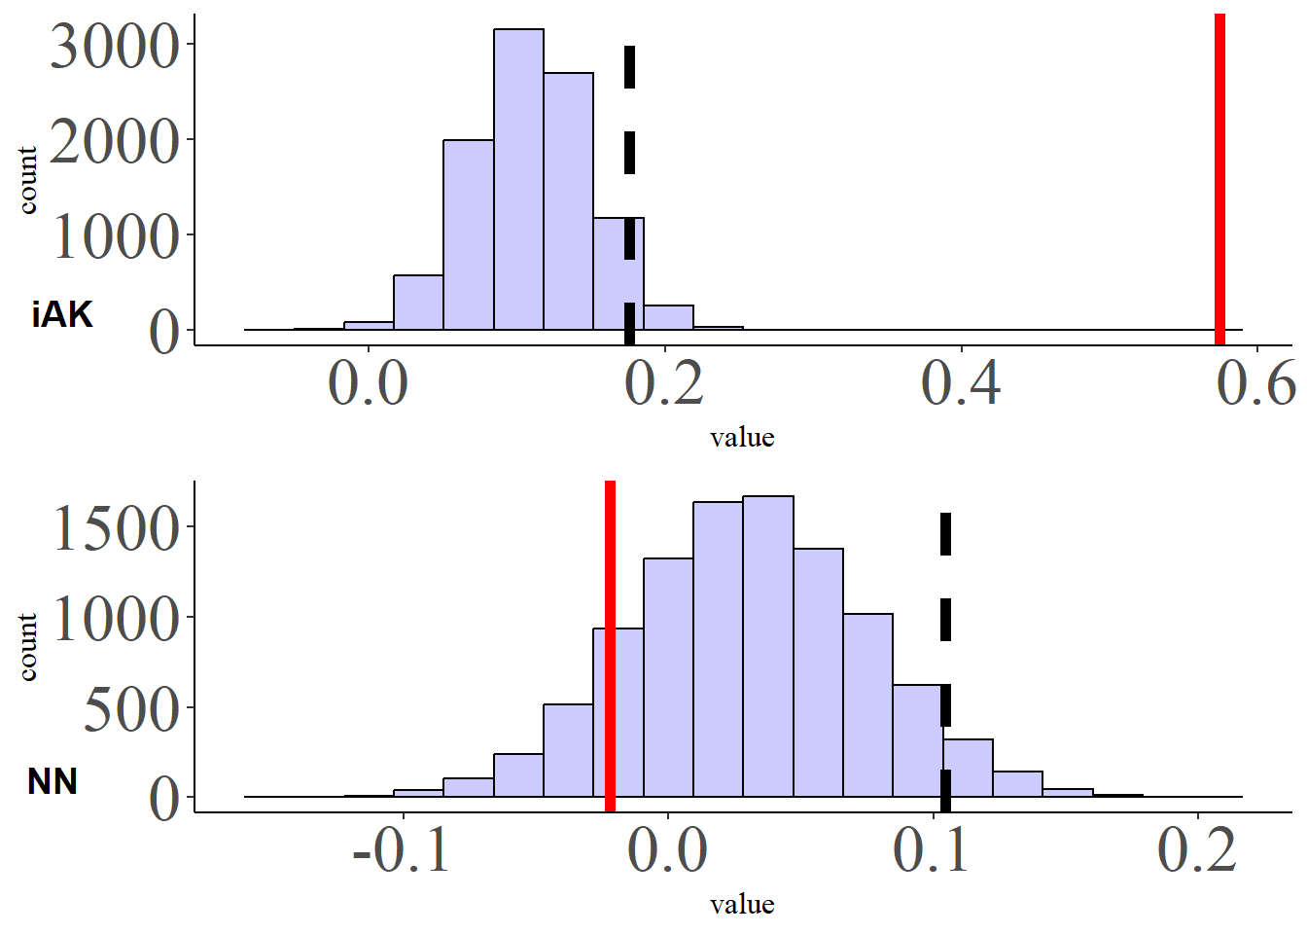
Regression NN and invAK Models: Data Koppold et al., 2023
permutation test
Individual-based similarity

Slide 22
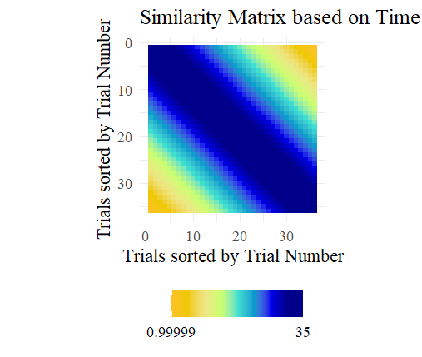
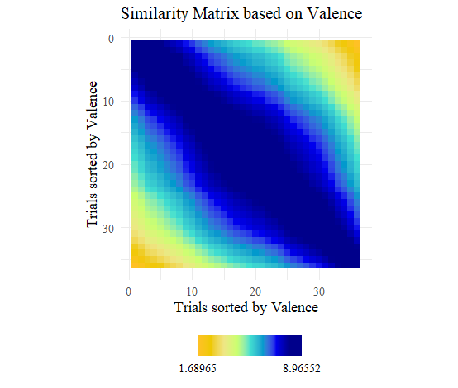
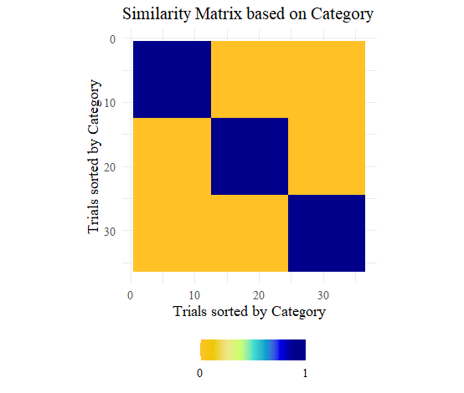
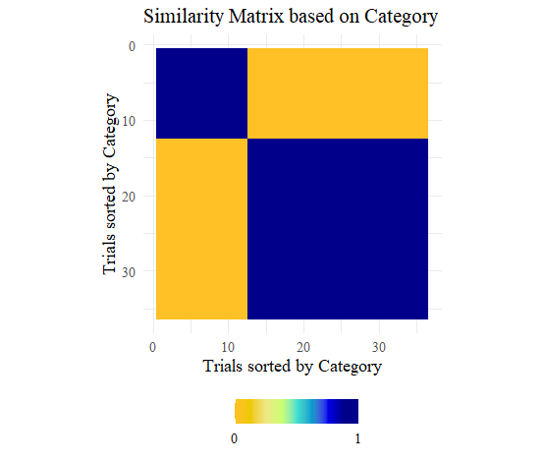
Does the invAK model predict SCR beyond other models
Time Model
Category Model
Category2 Model
Valence/Arousal
N
N
P
Aro
U

Slide 23
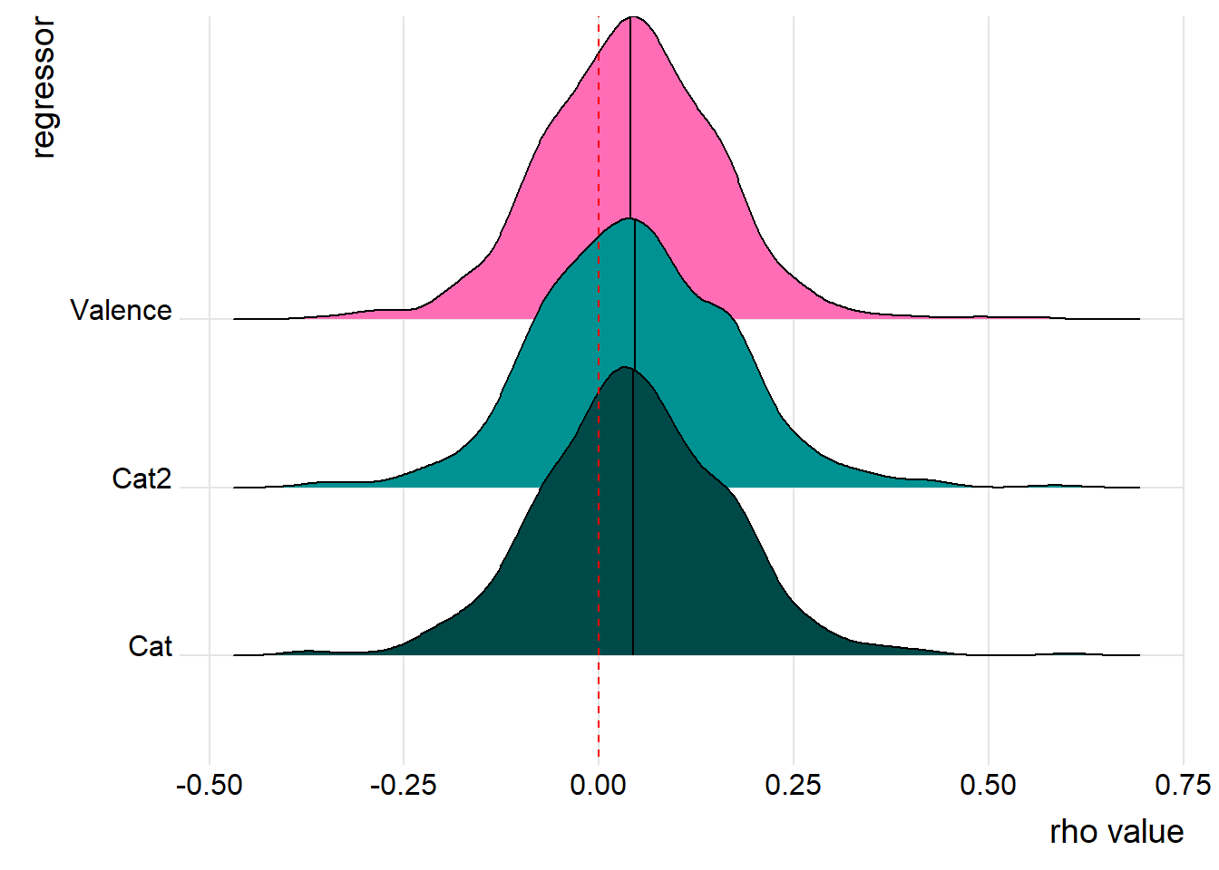
the invAK model is related to the SCR response pattern beyond other models (data Koppold et al., 2023)
rho= .04
rho= .046
rho= .044
p < .001

Slide 24
Is this result replicable with the data from Ventura-Bort et al., 2022?
Passive Picture Viewing Task (PPV)
Passive Sound Listening (PSL)
Imagery

Slide 25
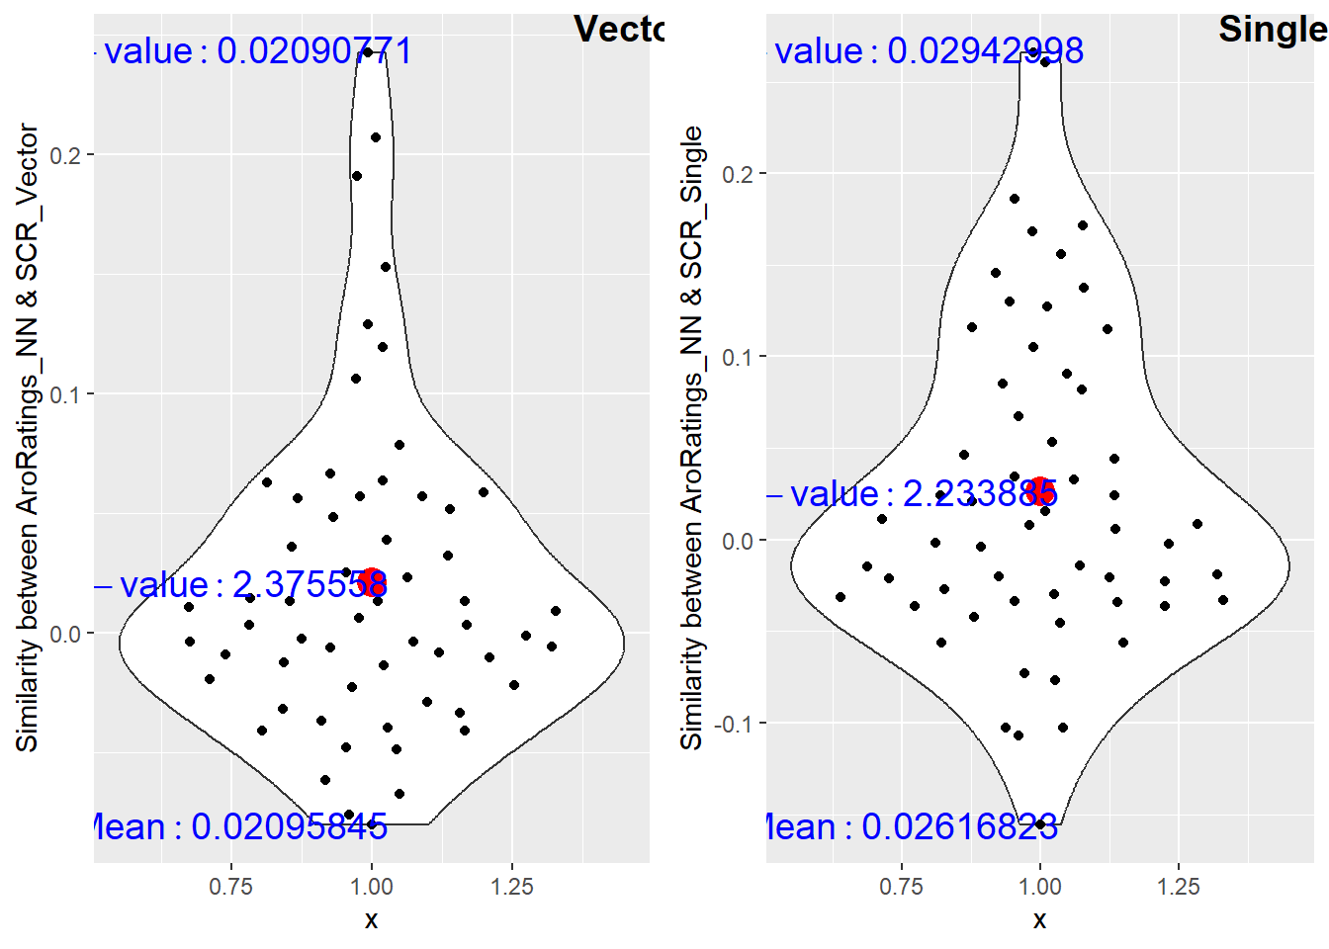





Comparison between RSMs of SCR and NN and invAK Model: (task picture viewing, PPV)
permutation test
Individual-based similarity

Slide 26




Regression NN and invAK Models:
(task Passive Picture Viewing, PPV)
permutation test
Individual-based similarity

Slide 27

the invAK model is related to the SCR response pattern beyond other models (task Passive Picture Viewing, PPV)
rho= .11
rho= .12
rho= .08
rho= .12
p < .001

Slide 28

Is this result replicable with the data from Ventura-Bort et al., 2022?
Passive Picture Viewing Task (PPV)
Passive Sound Listening (PSL)
Imagery
Passive Picture Viewing Task (PPV)
Passive Sound Listening (PSL)
Imagery
effect found for the invAK model, not AK

Slide 29
How is it in the other Tasks of Ventura-Bort et al., 2022?
2. Passive Sound Listening

Slide 30






Comparison between RSMs of SCR and NN and invAK Model: PSL
permutation test
Individual-based similarity

Slide 31



Regression NN and invAK Models: PSL
permutation test
Individual-based similarity

Slide 32

the invAK model is related to the SCR response pattern beyond other models. PSL
rho= .07
rho= .06
rho= .05
rho= .06
p < .003

Slide 33
How is it in the other Tasks of Ventura-Bort et al., 2022?
3. Imagery

Slide 34






Comparison between RSMs of SCR and NN and invAK Model: Imagery
permutation test
Individual-based similarity

Slide 35



Regression NN and invAK Models: Imagery
Individual-based similarity
permutation test

Slide 36

the invAK model is related to the SCR response pattern beyond other models. imagery
rho= .07
rho= .06
rho= .09
p < .005

Slide 37
Summary SCR
The higher the arousal level of an event (presumably higher SCR), the less similar it becomes to similarly rated events.
This pattern is found across stimulus types and samples.
The SCR is not indicative of the level of arousal experienced in a particular event
The physiological reactivity is not dependent on the category assigned to the particular event, but more strongly dependent on context and individual factors.
Do low arousing events evoke similar responses to each other and different to high arousing events?
Bottom effects? Trials evoking little or no responses are similar to each other due to that condition. But the lack of a response should not be an indicative of the degree of a category.

Slide 38
Research Questions
What is the similarity between physiological reactivity during affective processing tasks with the affective dimensions of valence and arousal?
Two measures:
Skin Conductance Response as a correlate of arousal
Startle blink reflex as a correlate of valence

Slide 39






Comparison between RSMs of STR and NN and AK Model: data Koppold et al., 2023
permutation test
Individual-based similarity

Slide 40



Regression NN and AK Models: Passive Picture Viewing data Koppold et al., 2023
permutation test
Individual-based similarity

Slide 41

the AK model is related to STR response pattern beyond other models data Koppold et al., 2023
M= .039
M= .038
M= .036
M= .034
p < .005

Slide 42

Is this result replicable with the data from Ventura-Bort et al., 2022?
Passive Picture Viewing Task (PPV)
Passive Sound Listening (PSL)
Imagery
Passive Picture Viewing Task (PPV)
Passive Sound Listening (PSL)
Imagery
effect found for the AK model, not invAK

Slide 43
Summary of Startle
The less pleasant an event is (presumably higher Startle responses), the less similar it becomes to similarly rated events.
This pattern is however not replicated in Ventura-Bort et al., 2022.
The Startle is not indicative of the level of valence experienced in a particular event
The physiological reactivity is not dependent on the category assigned to the particular event, but more strongly dependent on context and individual factors.
Are reactions to pleasant events similar to each other and different to other less pleasant events?
Bottom effects? Trials evoking little or no responses are similar to each other due to that condition. But the lack of a response should not be an indicative of the degree of a category.
Additional test to check for the robustness of the results:
Test with further datasets with passive picture viewing tasks.
Split the data set in 2/3 subsets

Slide 44






Comparison across data sets and tasks
Imagery Ventura-Bort et al., 2022
PPV Ventura-Bort et al., 2022
non-similar patterns across tasks and samples
PSL Ventura-Bort et al., 2022

Slide 45





Comparison between RSMs of STR and NN and AK Model: (PPV)
permutation test
Individual-based similarity

Slide 46



Regression NN and AK Models: Passive Picture Viewing (PPV)
permutation test
Individual-based similarity

Slide 47

the AK model is NOT related to STR response pattern beyond other models
rho= .005
rho= .01
rho= .01
rho= .01
p > .6

Slide 48





Comparison between RSMs of STR and NN and AK Model: (PSL)
permutation test
Individual-based similarity

Slide 49



Regression NN and AK Models: Passive Sound Listening (PSL)

Slide 50

the AK model is related to STR response pattern beyond other models
rho= .03
rho= .02
rho= .03
rho= .02
p <.04

Slide 51





Comparison between RSMs of STR and NN and AK Model: Imagery
permutation test
Individual-based similarity

Slide 52



Regression NN and AK Models: Imagery
permutation test
Individual-based similarity

Slide 53

the AK model is NOT related to STR response pattern beyond other models
rho= .04
rho= .04
rho= .04
rho= .04
p >.3

Slide 54
take home message
Every exciting events is different... and every unpleasant too!
Variable Physiological Responses to Affective Material Beyond Valence and Arousal Dimensions
alternative: “All non-arousing events are alike; each arousing event is arousing in its own way”

Slide 55
*** END

Slide 57

Comparison between RSMs of SCR and NN and invAK Model: Passive Picture Viewing (PPV)

Slide 58



Testing other models
Model invAK significant after regressing model Time
Model Time:

Slide 59



Testing other models
Model invAK significant after regressing model Category
Model Category (pleasant, unpleasant and neutral):

Slide 60



Testing other models
Model invAK significant after regressing model Category 2
Model Category 2 (non-arousing,arousing):

Slide 61



Testing other models
Model invAK significant after regressing model Valence
Model Valence

Slide 63

Comparison between RSMs of SCR and NN and invAK Model: Koppold et al., 2023

Slide 64



Testing other models Koppold et al., 2023
Model invAK significant after regressing model Category
Model Category (pleasant, unpleasant and neutral):

Slide 65



Testing other models Koppold et al., 2023
Model invAK significant after regressing model Category 2
Model Category 2 (non-arousing,arousing):

Slide 66



Testing other models Koppold et al., 2023
Model invAK significant after regressing model Valence
Model Valence

Slide 67

Comparison between RSMs of SCR and NN and invAK Model: PSL

Slide 68



Testing other models PSL
Model invAK significant after regressing model Time
Model Time:

Slide 69



Testing other models PSL
Model invAK significant after regressing model Category
Model Category (pleasant, unpleasant and neutral):

Slide 70



Testing other models PSL
Model invAK significant after regressing model Category 2
Model Category 2 (non-arousing,arousing):

Slide 71



Testing other models PSL
Model invAK significant after regressing model Valence
Model Valence

Slide 72

Regression NN and invAK Models: Imagery

Slide 73



Testing other models Imagery
Model invAK significant after regressing model Category
Model Category (pleasant, unpleasant and neutral):

Slide 74



Testing other models Imagery
Model invAK significant after regressing model Category 2
Model Category 2 (non-arousing,arousing):

Slide 75



Testing other models Imagery
Model invAK significant after regressing model Valence
Model Valence

Slide 78



Testing other models
ModelAK nonsignificant after regressing model Time
Model Time:

Slide 79



Testing other models
Model AK nonsignificant after regressing model Category
Model Category (pleasant, unpleasant and neutral):

Slide 80



Testing other models
Model AK nonsignificant after regressing model Category 2
Model Category 2 (non-arousing,arousing):

Slide 81



Testing other models
Model AK nonsignificant after regressing model Arousal
Model Arousal

Slide 83



Testing other models
ModelAK significant after regressing model Time
Model Time:

Slide 84



Testing other models
Model AK significant after regressing model Category
Model Category (pleasant, unpleasant and neutral):

Slide 85



Testing other models
Model AK significant after regressing model Category 2
Model Category 2 (non-arousing,arousing):

Slide 86



Testing other models
Model AK significant after regressing model Arousal
Model Arousal

Slide 88
Testing other models
ModelAK significant after regressing model Time
Model Time:

Slide 89
Testing other models
Model AK significant after regressing model Category
Model Category (pleasant, unpleasant and neutral):

Slide 90
Testing other models
Model AK significant after regressing model Category 2
Model Category 2 (non-arousing,arousing):

Slide 91
Testing other models
Model AK significant after regressing model Arousal
Model Arousal

